Slide 1
Certificate
This is to certify that experiments written in the record file had been performed by the student satisfactorily in partial fulfilment of the requirement for the AISSCE-2021 of Class XI is a genuine work done under my supervision. No part of this record file has ever been submitted for any other exam in this school or any other school or institute.
Signature of internal examiner
Signature of external examiner
School Stamp
Date: ………….

Slide 2
General work procedure for students
When entering a laboratory, avoid touching equipment, chemicals, electrical and electronic devices, or other materials until you are instructed to do so.
Follow all written and verbal instructions carefully given by the teacher/ instructor.
Do not start any practical work unless you are clear about its directions. Ask your teacher before proceeding with the activity.
Be cautious at all times in the laboratory. Call the teacher immediately if you notice any risky conditions.
Never work alone in the laboratory. The presence of a teacher or supervisor is necessary.
In case of spillage, breakage or injury, report to the teacher instantly: stay calm.
When removing an electrical plug from its socket, switch off and grasp the plug, not the electrical cord. Hands must be dry when touching an electrical switch, plug or outlet/ socket.
Never return unused equipment to their original container.
Do not immerse hot glassware in cold water, as the glassware may break. Put the heated glassware in a different place to be cooled.
Never look into a container that is being heated. Always observe containers from sideways.
If the Bunsen burner goes out accidentally, immediately turn off the control device/ gas supply.
Wash your hands with liquid soap and water on leaving the laboratory.

Slide 3
INDEX
S.No. | Title of the experiment | Date | Remarks
 | Experiment
1 | To prepare a temporary mount to observe pollen germination.
2 | To study the plant population density by quadrat method.
3 | To study the plant population frequency by quadrat method.
4 | To prepare a temporary mount of onion root tip to study mitosis.
5 | To isolate DNA from available plant material such as spinach, green pea seeds, papaya, etc.
 | Spottings
1 | Flowers adapted to pollination by different agencies (wind, insects, birds).
2 | Pollen germination on stigma through a permanent slide or scanning electron micrograph.
3 | Identification of stages of gamete development, i.e., T.S. of testis and T.S. of ovary through permanent slides (from grasshopper/mice).
4 | Meiosis in onion bud cell or grasshopper testis through permanent slides.
5 | T.S. of blastula through permanent slides (Mammalian).
6 | Mendelian inheritance using seeds of different colour/sizes of any plant.
7 | To study prepared pedigree chart of colour blindness (other optional; rolling of tongue, blood groups, ear lobes, widow's peak)
8 | Controlled pollination - emasculation, tagging and bagging.
9 | Common disease causing organisms like Ascaris, Entamoeba, Plasmodium, any fungus causing ringworm through permanent slides, models or virtual images or specimens. Comment on symptoms of diseases that they cause.
10 | Models specimen showing symbolic association in root modules of leguminous plants, Cuscuta on host, lichens.
11 | Flash cards models showing examples of homologous and analogous organs.

Slide 4
Aim: To prepare a temporary mount to observe pollen germination.
Principle:
In nature, pollen grains germinate and form pollen tubes after they get deposited by the process of pollination on compatible stigma. Pollen grains can be induced to germinate in a synthetic nutrient medium. Pollen tube is made up of cellulose, is an extension of intine -the inner wall of pollen grain. It emerges through one of the germ pore and passes through tissues of stigma and style to reach the ovule. The growing pollen tube is observed by staining with cotton blue. Pollen grain contains two cells
vegetative/tube cell (bigger in size, with irregularly shaped nucleus, dense cytoplasm, has abundant food reserve)
generative cells (spindle shaped, small and floats in the cytoplasm of the vegetative cell)
Generative cell divides mitotically to give rise to the two male gametes.
Requirement: Freshly plucked flowers with mature pollen grains of (china rose, petunia, sun flower, etc), petridish, glass slides, coverslips, brush, needle, microscope, beaker, 10% sucrose solution, boric acid, calcium nitrate, magnesium sulphate, potassium nitrate
Preparation of nutrient solution:
Method I: Dissolve dissolving 10 g sucrose, 30 mg calcium nitrate and 10 mg boric acid in 100ml of distilled water.
Method II: Dissolve 10 grams sucrose, 10 milligrams boric acid, 30 milligrams magnesium sulphate and 20 milligrams potassium nitrate in 100ml of distilled water.
Procedure:
Prepare the nutrient medium of 10% sucrose solution.
Take a drop of 10% sucrose solution on a clean glass slide.
Sprinkle few pollen grains from mature stamen to the slide.
Place the cover slip over the glass slide and gently press it.
After 15 minutes, place the glass slide on the stage of the compound microscope.
Observe the slide through the microscope regularly for about half an hour.
Discussion:
Although pollen grains of many species germinate and put forth pollen tubes in this medium, the time taken for germination varies indifferent species. In the nutrient medium, the pollen grain germinates. The tube cell enlarges and comes out of the pollen grain through one of the germ pores to form a pollen tube. The tube nucleus descends to the tip of the pollen tube. The generative cell while passing through pollen tube divides into two male gametes.
Precautions
Freshly picked flowers should have mature stamens with dehisced pollen grains.
You should stain the specimen well. Extra stain should be removed using blotting paper.
Careful while placing the coverslip to avoid any bubble in the slide.
Do not apply too much of pressure on the cover slip. It may break.
Observation
Figure Microscopic view of germination of pollen
Must watch video link: https://youtu.be/S4wAtd11S5Y

Slide 5
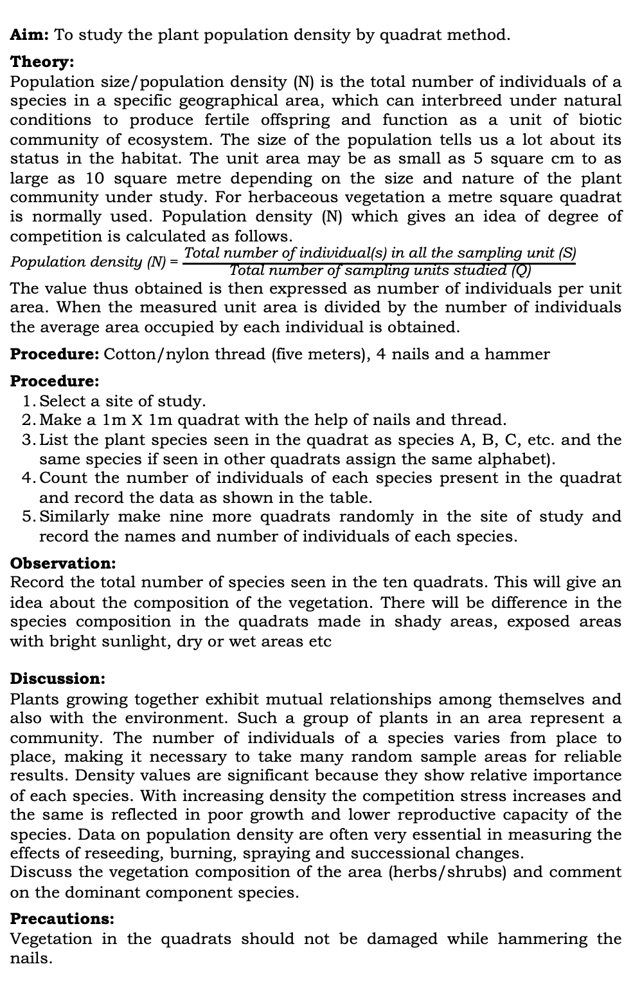
Aim: To study the plant population density by quadrat method.
Theory:
Population size/population density (N) is the total number of individuals of a species in a specific geographical area, which can interbreed under natural conditions to produce fertile offspring and function as a unit of biotic community of ecosystem. The size of the population tells us a lot about its status in the habitat. The unit area may be as small as 5 square cm to as large as 10 square metre depending on the size and nature of the plant community under study. For herbaceous vegetation a metre square quadrat is normally used. Population density (N) which gives an idea of degree of competition is calculated as follows.
Population density (N) = $\frac{\text{Total} \text{number} \text{of} \text{individual}\text{(}\text{s}\text{) }\text{in} \text{all} \text{the} \text{sampling} \text{unit}\text{ (}\text{S}\text{)}}{\text{Total} \text{number} \text{of} \text{sampling} \text{units} \text{studied}\text{ (}\text{Q}\text{)}}$
The value thus obtained is then expressed as number of individuals per unit area. When the measured unit area is divided by the number of individuals the average area occupied by each individual is obtained.
Procedure: Cotton/nylon thread (five meters), 4 nails and a hammer
Procedure:
Select a site of study.
Make a 1m X 1m quadrat with the help of nails and thread.
List the plant species seen in the quadrat as species A, B, C, etc. and the same species if seen in other quadrats assign the same alphabet).
Count the number of individuals of each species present in the quadrat and record the data as shown in the table.
Similarly make nine more quadrats randomly in the site of study and record the names and number of individuals of each species.
Observation:
Record the total number of species seen in the ten quadrats. This will give an idea about the composition of the vegetation. There will be difference in the species composition in the quadrats made in shady areas, exposed areas with bright sunlight, dry or wet areas etc
Discussion:
Plants growing together exhibit mutual relationships among themselves and also with the environment. Such a group of plants in an area represent a community. The number of individuals of a species varies from place to place, making it necessary to take many random sample areas for reliable results. Density values are significant because they show relative importance of each species. With increasing density the competition stress increases and the same is reflected in poor growth and lower reproductive capacity of the species. Data on population density are often very essential in measuring the effects of reseeding, burning, spraying and successional changes.
Discuss the vegetation composition of the area (herbs/shrubs) and comment on the dominant component species.
Precautions:
Vegetation in the quadrats should not be damaged while hammering the nails.
Observation
Plant Species | Quadrats employed in study & no. of individuals in each quadrat |  |  |  |  |  |  |  |  |  | Total No. of individuals (S) | Total no. of Quadrats studied (Q) | Population density (N)
 | 1 | 2 | 3 | 4 | 5 | 6 | 7 | 8 | 9 | 10
A | 1 | - | 2 |  | 7 | 5 | 3 |  | 5 | - | 23 | 10 | 23/10 =2.3
B | 3 | 2 | - | 4 | 5 | 1 | 2 | 5 | 3 | - | 25 | 10 | 25/10 = 2.5
Figure Density studies of the given vegetation
Must watch video link: https://youtu.be/FlwR-EGE9zA

Slide 6
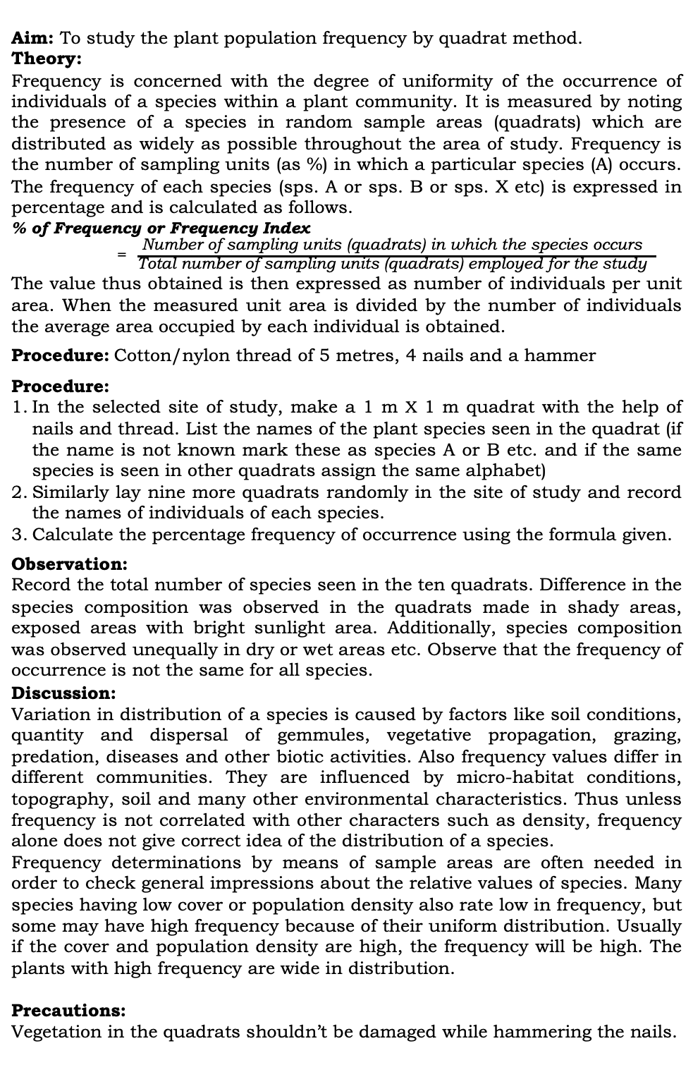
Aim: To study the plant population frequency by quadrat method.
Theory:
Frequency is concerned with the degree of uniformity of the occurrence of individuals of a species within a plant community. It is measured by noting the presence of a species in random sample areas (quadrats) which are distributed as widely as possible throughout the area of study. Frequency is the number of sampling units (as %) in which a particular species (A) occurs. The frequency of each species (sps. A or sps. B or sps. X etc) is expressed in percentage and is calculated as follows.
% of Frequency or Frequency Index
= $\frac{\text{Number} \text{of} \text{sampling} \text{units}\text{ (}\text{quadrats}\text{) }\text{in} \text{which} \text{the} \text{species} \text{occurs} }{\text{Total} \text{number} \text{of} \text{sampling} \text{units}\text{ (}\text{quadrats}\text{) }\text{employed} \text{for} \text{the} \text{study} }$
The value thus obtained is then expressed as number of individuals per unit area. When the measured unit area is divided by the number of individuals the average area occupied by each individual is obtained.
Procedure: Cotton/nylon thread of 5 metres, 4 nails and a hammer
Procedure:
In the selected site of study, make a 1 m X 1 m quadrat with the help of nails and thread. List the names of the plant species seen in the quadrat (if the name is not known mark these as species A or B etc. and if the same species is seen in other quadrats assign the same alphabet)
Similarly lay nine more quadrats randomly in the site of study and record the names of individuals of each species.
Calculate the percentage frequency of occurrence using the formula given.
Observation:
Record the total number of species seen in the ten quadrats. Difference in the species composition was observed in the quadrats made in shady areas, exposed areas with bright sunlight area. Additionally, species composition was observed unequally in dry or wet areas etc. Observe that the frequency of occurrence is not the same for all species.
Discussion:
Variation in distribution of a species is caused by factors like soil conditions, quantity and dispersal of gemmules, vegetative propagation, grazing, predation, diseases and other biotic activities. Also frequency values differ in different communities. They are influenced by micro-habitat conditions, topography, soil and many other environmental characteristics. Thus unless frequency is not correlated with other characters such as density, frequency alone does not give correct idea of the distribution of a species.
Frequency determinations by means of sample areas are often needed in order to check general impressions about the relative values of species. Many species having low cover or population density also rate low in frequency, but some may have high frequency because of their uniform distribution. Usually if the cover and population density are high, the frequency will be high. The plants with high frequency are wide in distribution.
Precautions:
Vegetation in the quadrats shouldn’t be damaged while hammering the nails.
Observation
Plant Species | Number of quadrats employed in the study (Q) |  |  |  |  |  |  |  |  |  | No. of quadrats in which the species is present (N) | Percentage of frequency F=N/Q X 100
 | 1 | 2 | 3 | 4 | 5 | 6 | 7 | 8 | 9 | 10
A | ✔️ | ╳ | ✔️ | ✔️ | ╳ | ╳ | ✔️ | ╳ | ╳ | ✔️ | 5 | 5/10 x 100 = 50%
B | ╳ | ╳ | ╳ | ╳ | ✔️ | ╳ | ╳ | ╳ | ╳ | ╳ | 1 | 01/10 x 100 = 10%
Figure Frequency studies for the given vegetation
Must watch video link: https://youtu.be/uBYqBNyojMQ

Slide 7
Aim: Preparation and study of mitosis in onion root tips.
Principle:
Somatic growth in plants and animals takes place by the increase in the number of cells. A cell divides mitotically to form two daughter cells wherein the number of chromosomes remains the same (i.e., unchanged) as in the mother cell. In plants, such divisions rapidly take place in meristematic tissues of root and shoot apices, where the stages of mitosis can be easily observed. In animals, mitotically dividing cells can be easily viewed in the bone marrow tissue of a vertebrate, epithelial cells from gills in fishes and the tail of growing tadpole larvae of frog.
Requirement: Onion bulbs, wide mouth glass tubes/jar/bottle, glacial acetic acid, ethanol, 2-4% acetocarmine/acetoorcein stain, N/10 HCl, spirit lamp/hot plate, slide, cover slips, blotting paper, molten wax/nail polish and compound microscope,
Procedure for growing of root tips
Carefully remove the dry roots of few medium sized onion bulbs.
Grow root tips of onion bulbs for 3-6 days by placing these on top mouth of a cylindrical container filled with water such that stem ports of the bulbs just touches the water.
Water may be added periodically to compensate evaporation losses.
Cut 2–3 cm long freshly grown roots and transfer them to freshly prepared fixative, i.e., aceto-alcohol (1 part of glacial acetic acid : 3 parts of ethanol).
Keep the root tips in the fixative for 24 hours and then transfer them to 70% ethanol (for preservation and use in future).
Onion root-tip cells have a cell cycle of approximately 24-hour duration, i.e., they divide once in 24 hours, and this division usually takes place about two hours after sunrise. Therefore, roots grown on water should be cut only at that time to score maximum number of dividing cells.
Preparation of temporary mount of onion root tips to study mitosis
Take one or two preserved roots, wash them in water on a clean and grease-free slide.
Add one drop of N/10 HCl on the root tip followed by 2–3 drops of aceto-carmine or aceto-orcein stain.
Leave the slide for 5–10 minutes on a hot plate (or warm it slightly on spirit lamp).
Care should be taken that the stain is not dried up.
Carefully blot the excess stain using blotting paper.
Cut the comparatively more stained (2–3 mm) tip portion of the root and retain it on the slide and discard the remaining portion.
After 10–20 seconds, put one or two drops of water and blot them carefully using blotting paper.
Again put a drop of water on the root tip and mount a coverslip on it avoiding air bubbles. Place the slide in between the folds of blotting paper using the fingers in such a way that the cover slip mounted on the slide is properly held.

Slide 8
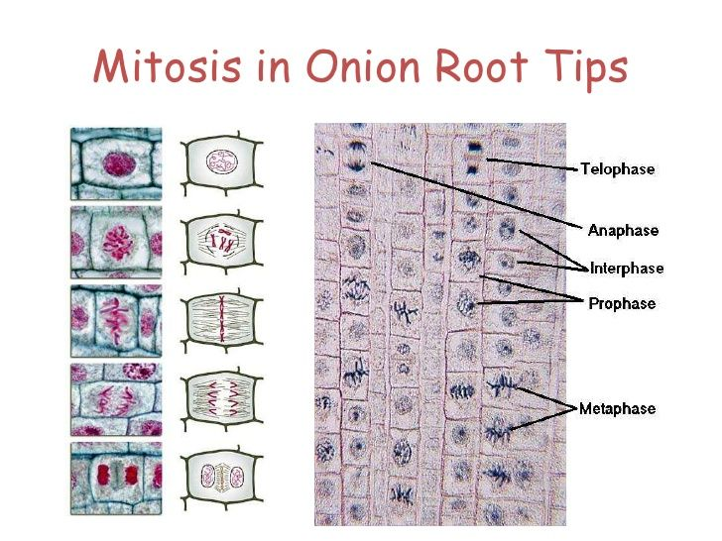
Observation
Now slowly tap the cover slip using the blunt end of a pencil so that the meristematic tissue of the root tip below the cover slip is properly squashed and spread as a thin layer of cells. Carefully seal the margins of the cover slip using molten paraffin wax or nail polish.
This preparation of onion root tips cells is now ready for the study of mitosis.
Observe the slide on the stage of a good quality compound microscope.
First observe it under the lower magnification (10 X objective) to search for the area having a few dividing cells.
Examine the dividing cells under higher magnification of the microscope to observe the detailed features of mitosis.
Observation
The stages of mitosis can be broadly categorised into two parts: karyokinesis (division of nucleus) followed by cytokinesis (division of cytoplasm, and ultimately of the cell). Those cells, which are not in the phases of cell division are considered to be in interphase. Most of the cells in a microscope field are in interphase few cells are found in other stages of cell cycle.
Interphase
The cells are mostly rectangular, oval or even circular in shape, with almost centrally situated densely stained nucleus. The chromatic (coloured) material of the nucleus is homogeneous and looks granular. The boundary of the nucleus is distinct. One or few nucleoli (sing: nucleolus) can also be observed inside the nucleus.
Prophase
Intact nuclear outline is seen. The chromatin (seen as a homogeneous material in the nucleus at interphase) appears as a network of fine threads(chromosomes). Few cells are found in the early stage of prophase with thing chromatin fibres (chromosomes). However, cells at late prophase were observed with comparatively thicker chromatin fibres. Besides this, in the late prophase the nuclear membrane may not be noticed.
Metaphase
The nuclear membrane disappears. Chromosomes are thick and are seen arranged at the equatorial plane of the cell. Each chromosome at this stage has two chromatids joined together at the centromere, which can be seen by changing the resolution of the microscope. Nucleolus is not observed during metaphase.
Anaphase
Separation of the chromatids of each chromosome is observed by splitting of the centromere. Each chromatid now represents a separate chromosome as it has its own centromere. The chromosomes are found as if they have moved towards the two poles of the cell. The chromosomes at this stage may look like the shape of alphabets 'V','J' or 'I' depending upon the position of centromere in them. Different anaphase cells show different stages of movement of chromosomes to opposite poles, and they are designated to represent early, mid and late anaphase
Interphase
Prophase
Metaphase
Anaphase
Telophase
Cytokinesis
Figure Microscopic view on left side and its diagrammatic representation on the right hand side

Slide 9
Telophase
Chromosomes reach the opposite poles, lose their individuality, and look like a mass of chromatin. Nuclear membrane reappears to form the nuclei of the two future daughter cells.
Cytokinesis
In plants, a cell plate is formed in the middle after telophase. The plate can be seen to extend outwards to ultimately reach the margin of the cell and divide the cell into two. Such cell plates are characteristic of plant cells. However, in an animal cell, the two sides of the cell show constrictions formed from the peripheral region in the middle of the cell, which grow inward and meet to divide the cell into two daughter cells.
Precautions
Careful while placing the coverslip to avoid any bubble in the slide.
Do not apply too much of pressure on the cover slip. It may break.

Slide 10
Observation
Aim: Isolate DNA from available plant material such as spinach, green pea seeds, papaya, etc.
Principle:
Deoxyribonucleic acid (DNA) is a long polymer of deoxyribonucleotides. It acts as the genetic material/genome in most of the organisms. The length of DNA is usually determined by base pairs (number of nucleotides/a pair of nucleotide). The human genome contains 3164.7 million nucleotide bases.
Each organism has its unique length of DNA. Pure DNA from a living cells can be isolated by breaking the cell with different enzymes lysozyme (bacteria), cellulase (plant cells), chitinase (fungus), lipase, etc. The RNA and proteins can be removed by treating with ribonuclease and protease respectively. The purified DNA can be precipitated out by chilled ethanol. Precipitated pure DNA appear as a collection of fine threads in the suspension. DNA that separates out can be removed by spooling using glass rod.
Requirement: Any available plant material (spinach, green pea seeds, papaya, etc.), mortar and pestle, test tubes, beakers, ethanol, liquid detergent/ meat tenderizer,
Procedure
Grind the plant sample using mortar and pestle with little amount of water and sodium chloride.
Transfer the homogenised plant material into a beaker.
Add liquid detergent or meat tenderizer to it and mix it properly with a glass rod for 3-5 minutes.
Filter the mixture using a sieve into a clean, dry and sterilised test tube.
Tilt the test tube with filtrate, and add chilled ethanol to allow precipitation of DNA.
After half-an-hour we can observe the precipitated DNA suspended in the supernatant as collection of fine threads.
DNA can be removed by spooling using glass rod.
Observation
The DNA appears as white precipitates of collection of fine threads at the top layer of ethanol.
Discussion:
Isolation of DNA involves mechanical method and use of enzymes. Grinding and crushing the plant sample using motor and pestle degrades the cell walls and membranes. The liquid detergent degrades membrane phospholipids and proteins, releasing the DNA . The sodium cations from the salt shield the negatively charged DNA molecules and allow collection and extraction of DNA in the mixture. Chilled ethanol precipitate DNA in the supernatant. The DNA is the white material in the clear top layer of alcohol layer and removed by spooling using glass rod.
Collection of fine threads of DNA
Chilled ethanol
Figure Spooling of DNA
Must watch video: https://youtu.be/boMZ_Y_OW3Y

Slide 11
SPOTTINGS

Slide 12
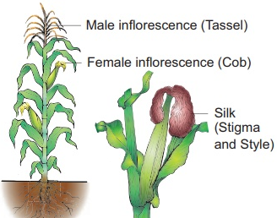
Aim: Flowers adapted to pollination by different agencies (wind, insects, birds).
Principle:
The process of transfer of pollen grains from the anther to the stigma of pistil(s) of flower(s) growing on plant(s) of same species is termed pollination. Flowering plants make use of external agents to achieve various ways of pollination. Pollination is important to achieve fertilization and production of seeds (from which new plants can be produced), conserve biodiversity, ensure stability of ecosystem, sustain agriculture and to ensure food security (production of crops, vegetables and fruits). Depending on the source of pollen, pollination can be self Pollination/Autogamy (Pollination within the same plant) or cross pollination/Xenogamy(Pollination between two different plants of same species). Geitonogamy is a type of self pollination which occurs from one flower to another flower of the same plant.
Requirement: Living material/charts/models of maize, sunflower, Ricinus, salvia, Ficus, pencil rubber, etc
Observation
I. Flowers adapted to wind pollination (Anemophily)
Animophily is a type of cross pollination involving transfer of pollen grains from the mature anthers to the stigma of another flower through the agency of wind . Some of the adaptations of flowers adapted to anemophily are;
The flowers are devoid of showy bracts and other floral structures like calyx and corolla.
Flowers are small, lack petals, nectar less, no bright colours and special odour.
Flowers may be staminate and pistillate flowers (dioecious), or these may be monoecious.
The produced pollen grains that are smooth, light and non-sticky so that they can be transported in wind current.
Flowers posses well exposed stamens (so that the pollens are easily dispersed into wind current).
Flowers posses large, feathery and well exposed stigma to easily trap air-borne pollen grains.
Flowers have a single ovule in each ovary.
Numerous flowers packed into an inflorescence.
In monoecious plants, male flowers are more abundant.
Flowers produce enormous amount of dry, light and non sticky pollens.
Some anemophilous plants are Zea mays (maize), Salix, Quercus, Rumex, Corylus, Grasses belonging to family Graminae and Cyperaceae (sedges), Juncaceae (rushes), Cannabis, Ricinus, Chenopodium, Amaranthus, etc.
Zea mays (maize) get pollinated by wind as follow;
Tassels of corn plant is male inflorescence and are well exposed in wind. Pollen get carried by wind.
Silk of corn cob are stigma and style which wave in the wind to trap pollen grains.
Observation
Zea mays (maize) is adapted to wind pollination (Anemophily)

Slide 13
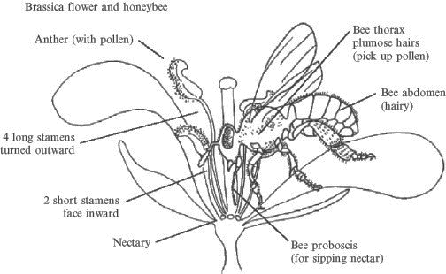
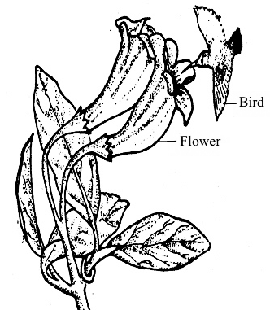
Observation
II. Flowers adapted to insect pollination (Entomophily)
Entomophily) is the transference of pollen of ripe anthers of one flower to mature stigma of another flower by the insects. It is the most common type of zoophily achieved by moths, butterflies, wasp, bees and beetles. The insects visit the flowers for edible pollen, nectar, as their food or for getting protection against wind, rain, high or low temperature. Entomophilous plants have the following adaptations:
Majority of insect pollinated flowers are large and colourful.
When the flowers are small, a number of flowers are clustered into an inflorescence to make them conspicuous. For example capitulum, umbel, spadix, etc.
Flowers often have pleasant fragrance (odour) and sweet nectar.
Pollen grains have a yellowish, viscous, sticky oily layer for easily sticking to the body of insect.
Stigmas are also sticky and rough to catch the pollen sticking to the body of insects.
Stamens and stigmas are inserted.
In some cases, pollen is edible, an attraction to insects for food e.g. rose , poppy, etc.
Most insect pollinated flowers have a landing platform e.g. Salvia.
In many cases special markings called nectar guides occur on the petals for guiding the insects to nectar glands. e.g. Viola (Pansy).
Stigmas are inserted and sticky.
II. Flowers adapted to pollination by birds (Ornithophily)
Ornithophily is the mode of cross pollination performed by few types of small size and long beaks birds. Common pollinating birds are sun birds (Afro-asia), humming birds (America). Some other pollinating birds are Crow, Bulbul, Parrot and Meynah. Ornithophilous plants are very few as compared to entomophilous plants . Only about 100 species of Australian plants are ornithophilous. Common bird pollinated plants are Bombax (Red Silk Cotton), Erythrina (Coral Tree), Callistemon (Bottle Brush), Butea monospermic, Bignonia, Lobelia Agave, Grevillea, etc. Ornithophilous plants have the following adaptations:
The ornithophilous flowers secrete abundant watery nectar or have edible parts.
The nectar is secreted in such abundance that drops of it can be brought down by shaking branches of Gravillea and Erythrina. Nectar is mainly made of sugar.
Ornithophilous flowers are usually brightly coloured - red , orange , yellow or blue.
The floral parts are commonly leathery.
In some cases, the corolla is funnel shaped.
Scent is often absent.
Figure Brassica flower and honey bee
Figure Ornithophilous flower

Slide 14
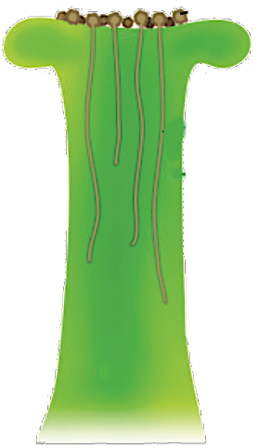
Observation
Aim: Pollen germination on stigma through a permanent slide or scanning electron micrograph.
Principle:
Pollen grains germinate and form pollen tubes after they get deposited by the process of pollination on compatible stigma. Pollen tube is made up of cellulose, is an extension of intine -the inner wall of pollen grain. It emerges through one of the germ pore and passes through tissues of stigma and style to reach the ovule. The growing pollen tube is observed by staining with cotton blue. Pollen grain contains two cells
vegetative/tube cell (bigger in size, with irregularly shaped nucleus, dense cytoplasm, has abundant food reserve)
generative cells (spindle shaped, small and floats in the cytoplasm of the vegetative cell)
Generative cell divides mitotically to give rise to the two male gametes.
Requirement: Permanent slide of pollen germination on stigma, compound microscope, lense cleaning paper and cleaning fluid,
Procedure
Clean the slide and microscope’s eye and objective lenses with the help of lens cleaning paper using any cleaning fluid.
Place the slide on the stage of the microscope and observe first under lower magnification and then in higher magnification. Observe various stages of gamete development.
Record your observations in the notebook and draw labelled diagrams.
Observation
Pollen germination on stigma
The pistil has the ability to recognise the pollen, whether it is of the right type (genetically compatible) or of the wrong type (incompatible).
Recognition of genetically compatible pollen/right type of pollen by stigma is mediated by chemical components of pollen and pistil
Vegetative cell forms pollen tube through stigma and style whereas generative cell divides mitotically to give rise to the two male gametes which passes through the pollen tube.
Growing pollen tube through the tissues of the stigma and style reaches the ovary.
Within the ovary, inside ovule; filiform apparatus present at the micropylar part guides the entry of pollen tube into embryo sac through synergids.
Two male gametes passes through pollen tube will be discharged into synergids and undergo double fertilization that leads to double fertilisation.
Figure Microscopic view of germination of pollen
Pollen grains
Style
Pollen tube
Style
Figure Growth of pollen tube in the style of a carpel

Slide 15
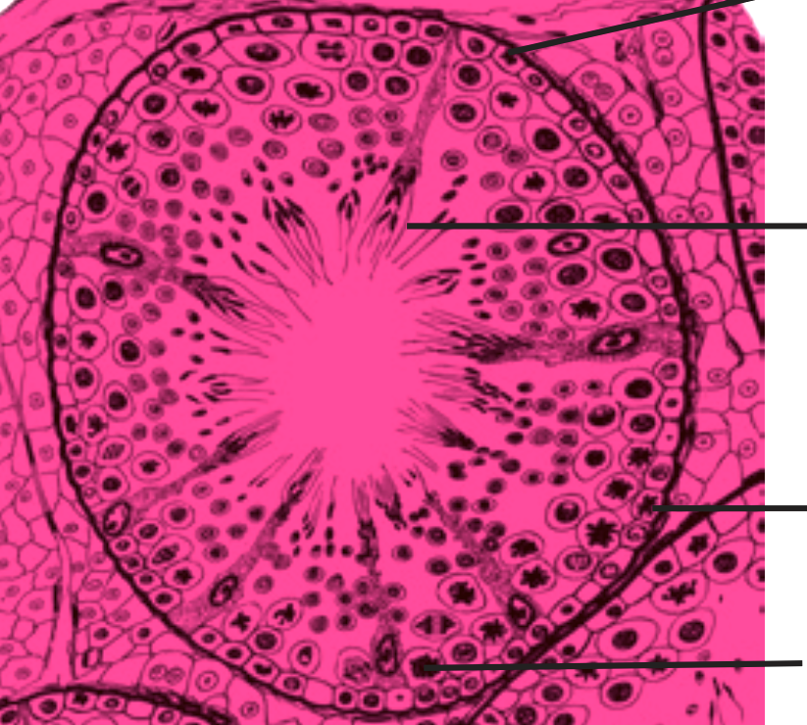
Aim: Identification of stages of gamete development, i.e., T.S. of testis and T.S. of ovary through permanent slides (from grasshopper/mice).
Principle:
Gametogenesis (process of gamete formation) in male and female animals takes place in their gonads, i.e., testis and ovary respectively. The gametogenesis involves meiotic cell division. The gametogenic development in testis is called spermatogenesis and in ovary it is oogenesis. They exhibit marked differences and can be examined in transverse section (T.S.) of these organs
Requirement: Permanent slides of T.S. of testis and ovary, compound microscope, lense cleaning paper and cleaning fluid,
Procedure
Clean the slide and microscope’s eye and objective lenses with the help of lens cleaning paper using any cleaning fluid.
Place the slide on the stage of the microscope and observe first under lower magnification and then in higher magnification. Observe various stages of gamete development.
Record your observations in the notebook and draw labelled diagrams.
Observation
I. Transverse Section (T.S.) testis
T.S of testis was found with large number of seminiferous tubules under lower magnification.
At higher magnification, a complete tubule is observed with various stages of gamete development from periphery towards lumen
Germinal epithelium, Spermatogonia, Primary spermatocytes, Secondary spermatocytes, spermatids and Spermatozoa were identified within the seminiferous tubule.
In T.S. of testis, the space between seminiferous tubules are filled with blood vessels and Leydig's cell or Interstitial cells.
II. Transverse Section (T.S.) of Ovary
In the T.S of ovary, there is a mass of tissue lined with germinal epithelium.
The ovum was found surrounded by one to several layers of follicular cells. As the ovum matures, the number of surrounding follicular cell layer increases.
In the later stage of follicular development a cavity called antrum appears.
The antrum gets further enlarged and the follicle grows bigger into Graafian follicle which ruptures to release the ovum (ovulation)
Ruptured Graafian follicles develop into Corpus luteum
Corpus luteum degenerate into a collagenous white body which persists for few months called Corpus albicans.
Discussion:
Spermatogenesis is a continuous process after attainment of puberty, and that is why gamete development and spermatozoa are observed in all seminiferous tubules. In case of ovary, the follicular development stages are observed
Observation
Spermatozoa
Primary spermatocyte
Secondary spermatocyte
Germinal epithelium
Spermatogonia
Figure Transverse Section (T.S.) testis showing seminiferous tubule
Graafian follicle
Antrum
Ovum
Corpus luteum
Corpus albicans
Figure Transverse Section (T.S.) Ovary

Slide 16
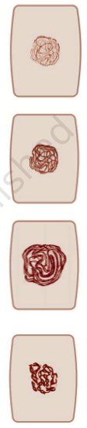
Observation
Aim: Meiosis in onion bud cell or grasshopper testis through permanent slides.
Introduction:
Meiosis is a type of cell division in which the number of chromosomes is halved (from diploid to haploid) in the daughter cells, i.e. during the gametogenesis. The division is completed in two phases, meiosis I and meiosis II. Meiosis I is a reductional division in which the chromosomes of homologous pairs separate from each other. Meiosis II is equational division resulting in the formation of four daughter cells. Stages of meiosis can be observed in a cytological preparation of the cells of testis tubules or in the pollen mother cells of the anthers of flower buds
Requirement: Permanent slides of meiosis and compound microscope
Procedure
Place the slide on the stage of the microscope and search for the dividing cells using lower magnification. When dividing cells are located observe them under higher magnification
Observation
Table Different stages of meiosis and their features
Leptotene
Zygotene
MEIOSIS I
1. Prophase I | Unlike the prophase of mitosis, it is a comparatively complex phase characterised by a number of events. Sub-phases can be identified in it. a) Leptotene (leptos = slender tene = band or thread) The nuclear membrane and nucleolus are not distinctly observable. Fine network of thin threads are seen uniformly distributed in the nucleus. These are chromatin threads, which may be observed as more prominent structures in the later stages. b) Zygotene (Zygon = paired) This stage is characterised by the pairing of the homologous chromosomes, which can be seen as paired chromatin threads (bivalents). (c) Pachytene (pachy = thick) The chromatin threads get condensed and appear shortened and thick. Pairs of homologous chromosomes can be seen. Each chromosome has two chromatids and thus each bivalent consists of four chromatids. This configuration is called tetrad. (d) Diplotene (diplos = double) The homologous chromosomes (each made up of two chromatids) show distinct separation from each other except at few regions where attachments are seen. These are chiasmata (sing. chiasma) representing the site of exchange of the parts between two homologous chromosomes (i.e. crossing over). (e) Diakinesis (Dia = opposite; kinesis= separation or movement) The homologous pair of chromosomes appear more shortened, thick and prominent. Chiasmata can be still observed. All the homologous pairs appear scattered in the cell.
Pachytene
Diplotene-Diakinesis
Figure Diagrammatic representation of sub-phases of Prophase I of Meiosis

Slide 17
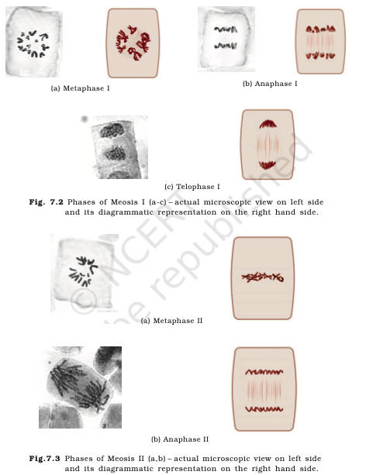
Observation
Meiosis I
2. Metaphase I | Homologous chromosomes are still in pairs, and are arranged along the equatorial plane of the cell. At this stage, the number of bivalents can be counted. Chiasmata may still be seen in a few bivalents
3. Anaphase I | The chromosome pairs appear to have moved towards the two opposite poles of the cell. At the later stage, the anaphase - I may show the assembly of chromosomes at two poles. This results into the reduction of number of chromosomes to half. This stage can be identified by the presence of two chromatids in such chromosome.
4. Telophase I | The chromosomes present at the two poles appear decondensed and form two distinct nuclei. Note: After the telophase I stage there may or may not be cytokinesis. Thereafter the cell enters into the second meiotic division.
MEIOSIS II
1. Prophase II | Distinct thread- like chromatin fibres or rod- shaped chromosome are seen
2. Metaphase II | This phase is similar to that of mitotic division (i) The chromosomes having two chromatids attached at the centromere are observed arranged at the equatorial plane of the cell. Note: Metaphase II of meiosis can be differentiated from metaphase-I on the basis of the following features: (ii) Each chromosome of metaphase II has two chromatid whereas in metaphase I these are paired homologous chromosomes each having two chromatids thus forming tetrad. (iii) In the metaphase I of meiosis, a few chiasmata are observed, where as no chiasmata are observed during metaphase II
3. Anaphase II | The two chromatids of each chromosome after separation appear to lie at the two poles of the cell. Note: Anaphase II can also be distinguished from the anaphase I of meiotic division on the basis of chromatids: In anaphase I, each chromosome has two distinct chromatids, but in anaphase II, each chromosome is represented by one chromatid only.
4. Telophase II | The separated chromosomes appear decondensed and form nuclei
Metaphase I
Anaphase I
Telophase I
Metaphase II
Anaphase II
Figure Diagrammatic representation of phases of Meiosis

Slide 18
Aim: Preparation and study of mitosis in onion root tips.
Principle:
Somatic growth in plants and animals takes place by the increase in the number of cells. A cell divides mitotically to form two daughter cells wherein the number of chromosomes remains the same (i.e., unchanged) as in the mother cell. In plants, such divisions rapidly take place in meristematic tissues of root and shoot apices, where the stages of mitosis can be easily observed. In animals, mitotically dividing cells can be easily viewed in the bone marrow tissue of a vertebrate, epithelial cells from gills in fishes and the tail of growing tadpole larvae of frog.
Requirement: Onion bulbs, wide mouth glass tubes/jar/bottle, glacial acetic acid, ethanol, 2-4% acetocarmine/acetoorcein stain, N/10 HCl, spirit lamp/hot plate, slide, cover slips, blotting paper, molten wax/nail polish and compound microscope,
Procedure for growing of root tips
Carefully remove the dry roots of few medium sized onion bulbs.
Grow root tips of onion bulbs for 3-6 days by placing these on top mouth of a cylindrical container filled with water such that stem ports of the bulbs just touches the water.
Water may be added periodically to compensate evaporation losses.
Cut 2–3 cm long freshly grown roots and transfer them to freshly prepared fixative, i.e., aceto-alcohol (1 part of glacial acetic acid : 3 parts of ethanol).
Keep the root tips in the fixative for 24 hours and then transfer them to 70% ethanol (for preservation and use in future).
Onion root-tip cells have a cell cycle of approximately 24-hour duration, i.e., they divide once in 24 hours, and this division usually takes place about two hours after sunrise. Therefore, roots grown on water should be cut only at that time to score maximum number of dividing cells.
Preparation of temporary mount of onion root tips to study mitosis
Take one or two preserved roots, wash them in water on a clean and grease-free slide.
Add one drop of N/10 HCl on the root tip followed by 2–3 drops of aceto-carmine or aceto-orcein stain.
Leave the slide for 5–10 minutes on a hot plate (or warm it slightly on spirit lamp).
Care should be taken that the stain is not dried up.
Carefully blot the excess stain using blotting paper.
Cut the comparatively more stained (2–3 mm) tip portion of the root and retain it on the slide and discard the remaining portion.
After 10–20 seconds, put one or two drops of water and blot them carefully using blotting paper.
Again put a drop of water on the root tip and mount a coverslip on it avoiding air bubbles. Place the slide in between the folds of blotting paper using the fingers in such a way that the cover slip mounted on the slide is properly held.

Slide 19
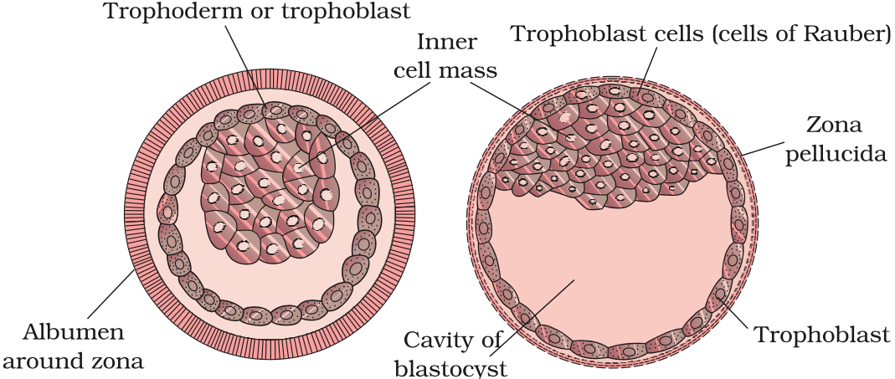
Observation
Aim: T.S. of blastula through permanent slides (Mammalian)
Introduction:
The zygote undergoes a few cycles of mitotic divisions to form a solid ball of cells called morula. The cells continue to divide and at a later stage a cavity is formed within it. This stage is blastula. The internal structural details of blastula can be observed in its transverse section. The trophoblast layer will be attached to the endometrium. The inner cell mass gets differentiated as the embryo. After attachment, the uterine cells divide rapidly and covers the blastocyst. Gradually, blastocyst becomes embedded in the endometrium of the uterus (implantation) and it leads to pregnancy.
Requirement: Permanent slide, chart/model of T.S. of blastula, compound microscope, lens cleaning fluid and paper
Procedure
Place the slide on the stage of the microscope and observe for feature of blastula at lower magnification.
Observation
In transverse section, the blastula appears as a sphere featuring a cavity called blastocoel within it with an outer layer of blastomeres called trophoblast/trophoderm. A cellular mass, adhered to the trophoblast is present on one end of the blastula is called inner cell mass.
Figure Diagrammatic representation of Blastula stage of a mammal

Slide 20
Observation
Aim: Prepared pedigree charts of colour blindness.
Introduction:
Pedigree analysis is a system to analyse the distribution and movement of characters in the family tree. Genetic traits (diseases) can be sex linked recessive disease i.e. gene for disease is present on X chromosome. For examples; Haemophilia, Colour blindness, etc. The autosome linked recessive disorders have mutant allele on autosome. For examples; Sickle cell anaemia, Phenylketonuria, Thalassemia, etc.
Autosome linked recessive disorders can be either autosome Linked Dominant traits (encoding gene is present on any one of the autosomes) or autosomal Recessive trait (mutant allele is recessive to its wild type allele).
Requirement: Pedigree charts of rolling of tongue, blood groups, ear lobes, widow's peak and colour blindness, Information about characters/traits in a family for more than one generation
Procedure
Select a family in which colour blindness are found.
Ask the person exhibiting the trait to tell in which of his/her parents, grand parents (both maternal and paternal), their children and grand children the trait in question is present.
Among surviving individuals the trait may also be examined.
The information made available is the basis for the preparation of pedigree chart using the appropriate symbols.
A careful examination of the pedigree chart would suggest whether the gene for the character is autosome-linked dominant or recessive, X-chromosome linked dominant or recessive, Y- chromosome linked or not.
Explanation
Colour blindness is commonly known as colour vision deficiency.
Colour blindness is a sex-linked recessive disorder i.e. gene for colour blindness is present on X chromosome.
It results in defect in either red or green cone of eye resulting in inability to distinguish between red and green colour.
It is observed more in males because of presence of only one X chromosome as compared to two chromosomes of females.
Pedigree chart showing inheritance of colour blindness is as shown.
Normal female
Marriage
Normal male
Parents
(Offsprings from a marriage)
Affected female
Siblings
Affected male
Affected female
Affected male
Figure Symbols used for preparation of Human Pedigree Analysis
Figure Pedigree chart showing inheritance of colour blindness

Slide 21
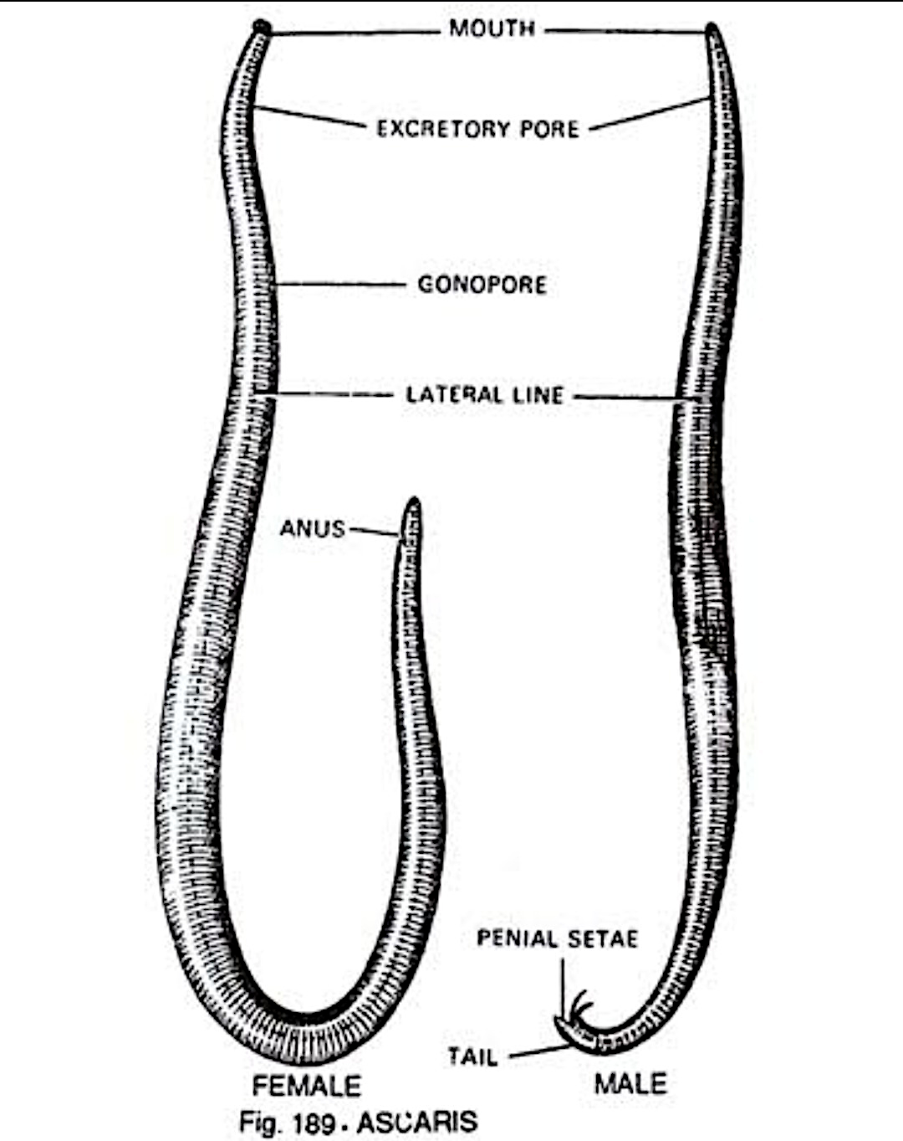
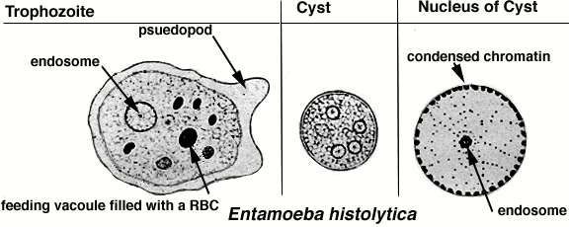
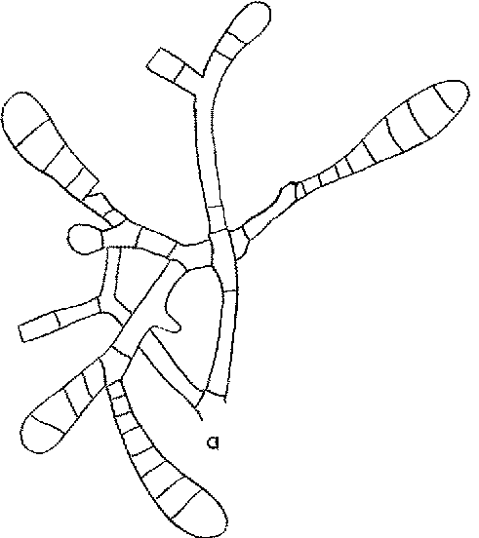
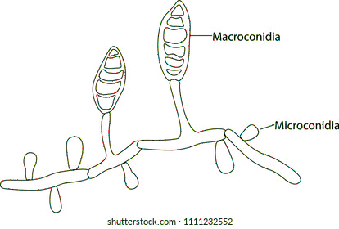
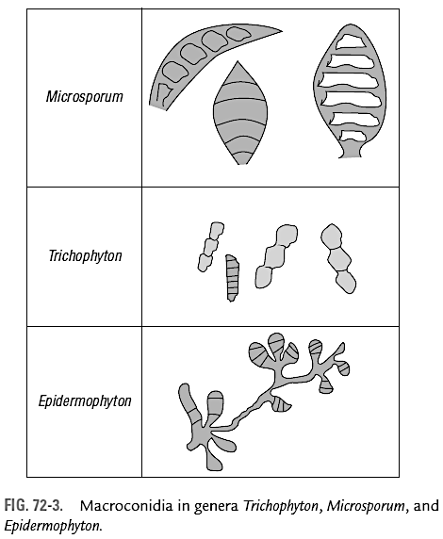
Observation
Aim: Common disease causing organisms –Ascaris, plasmodium, Entamoeba histolytica, and a fungi
Requirement: Permanent slide, chart/model of T.S. of blastula, compound microscope, lens cleaning fluid and paper
Procedure
Place the slide on the stage of the microscope and observe for feature of blastula at lower magnification.
Observation
Ascaris –a helminths
Ascaris lumbricoides is the "large roundworm" growing to a length of up to 35 cm.
It is an intestinal parasite and causes Ascariasis.
Symptoms of ascariasis can be Internal bleeding, muscular pain, fever, anemia and blockage of the intestinal passage.
The eggs of the parasite are excreted along with the faeces of infected persons which contaminate soil, water, plants, etc. A healthy person acquires this infection through contaminated water, vegetables, fruits, etc.
Plasmodium –a Protozoan
Plasmodium species can be Plasmodium vivax, Plasmodium malaria and Plasmodium falciparum.
Plasmodium falciparum causes malignant malaria and can even be fatal.
Plasmodium has dual host namely female Anopheles mosquito and human body.
Vector of Plasmodium is female Anopheles mosquito.
Symptoms of malaria include Chill and high fever recurring every three to four days. Some people may experience: Abdomen and muscle pain, fatigue, fever, night sweats, shivering, or sweating, Diarrhoea, nausea, or vomiting fast heart rate, headache, mental confusion,
Entamoeba histolytica –a Protozoan
Entamoeba histolytica is a parasite in the large intestine of human
It causes Amoebiasis (amoebic dysentery)
Symptoms of the amoebiasis includes constipation, abdominal pain and cramps, stools with excess mucous and blood clots.
Vectors like Houseflies act as mechanical carriers and transmit the Entamoeba histolytica from faeces of infected person to food and food products, thereby contaminating them.
Drinking water and food contaminated by the faecal matter are the main mode of transmission of Amoebiasis.
Ringworm caused by fungi
Fungi belonging to the genera Microsporum, Trichophyton and Epidermophyton cause ringworm.
Ringworm is a common infection of the skin and nails by fungi belonging to the genera Microsporum, Trichophyton and Epidermophyton.
Fungal growth in skin folds (groin or between the toes) is supported by body heat and moisture.
Ringworms are generally acquired from soil or by using towels, clothes, comb, etc of infected individuals.
Appearance of dry, scaly lesions on various parts of the body such as skin, nails and Scalp. These lesions are accompanied by intense itching.
Figure Diagrammatic representation of pathogens
Ingested RBC
Nucleus
Trophozoite
Ectoplasm
Nucleus
Erythrocyte in food vacuole
Plasmodium
Figure Diagrammatic of microscopic view of various stages of plasmodium
Ascaris
Microsporum
Trichophyton
Epidermophyton

Slide 22
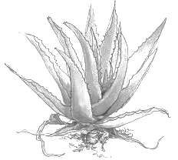
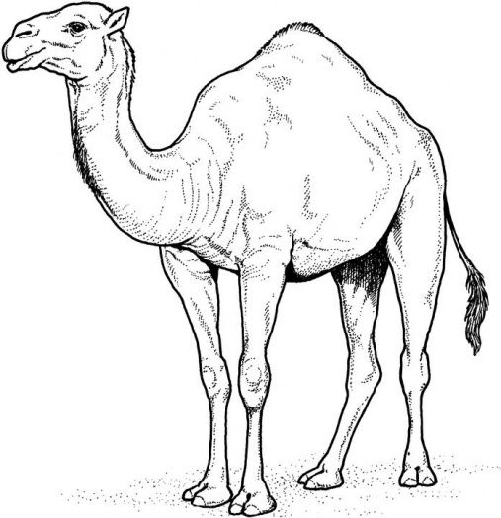
Observation
Aim: To study two plants and two animals found in xeric conditions.
Requirement: Living or preserved specimens/virtual picture of Aloe, opuntia, camel and Indian pangolin.
Observation
Aloe
It is a wild or cultivated shrub .
Stem is underground rhizome
Leaves are thick , succulent and arise in rosette .
Leaves are vertically placed to minimise exposure to sunlight .
Leaf - surface is smooth and shining .
Margins and apex are spiny to reduce transpiration .
Presence of thick - cuticle and sunken stomata on both the surfaces.
Shallow root system, much branched, abundant root hairs
Presence of mucilage in leaves.
Opuntia
Stem is flat, branched and succulent.
Flattened, green stem branches are photosynthetic called phylloclades.
Opuntia have no leaves (leaves are reduced to spines).
Special photosynthetic pathway Crassulacean acid metabolism -CAM that enables their stomata to remain closed during day time.
Presence of thick cuticle and sunken stomata minimise water loss through transpiration.
Camel
Camel is the most common domesticated animal of sandy deserts.
The hump of camel contains fat reserve, which is metabolised to produce water and heat.
Limbs are didactylous (only two digits in each limb) with large pads.
The large cushion like pads help the animal to walk on soft and sandy ground.
Eyes and nostrils bear heavy fringe of hairs to protect them from sand particles.
Stomach is three chambered and large with sacculated wall forming number water pockets.
To conserve water, very less water is lost through urine.
Anteater/Indian Pangolin (Manis crassicaudata)
Indian Pangolin lives both in burrows as well as trees.
The body is elongated 80-90 cm.
Overlapping horny scales are present on the dorsal sides.
Scales are modified hair.
Tail is long and covered dorsally by scales.
Head is small with a snout.
Eyes and ear small.
Tongue is long, sticky and protrusible.
The animal can roll into a ball at the time of danger
Spine
Fleshy leaf
Spiny leaf
Flattened and succulent stem
Stem
Aloe barbadensis
Opuntia
Figure Schematic diagram of xerophytes
Fat filled hump
Long eyelashes and bushy eyebrows
Large nostrils that can open and close
Two toed feet with thick pads
Figure Schematic diagram of camel
Scale
Sticky and protrusible tongue
Tail with dorsal scales
Clawed digits
Figure Schematic diagram of Manis crassicaudata

Slide 23
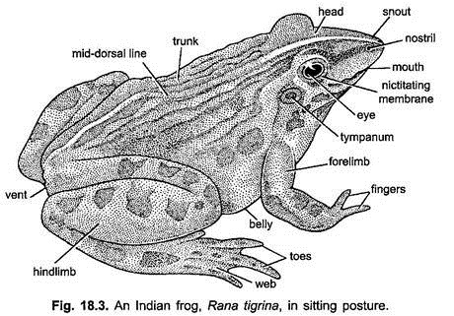
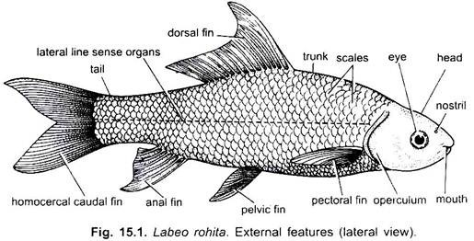
Observation
Aim: To study two plants and two animals found in aquatic conditions.
Requirement: Living or preserved specimens/virtual picture of Eichhornia, Nelumbo, Indian pangolin, and labeo rohita.
Observation:
Eichhornia (water hyacinth)
Plants are free floating, herbaceous, aquatic weeds, occur abundantly in ponds, lakes and ditches blocking water channels.
Plants grow by means of spongy offsets (stems), which show nodes and internodes.
Cluster of brown adventitious roots arise from each node . The roots act as balancers.
The root caps are absent . They are replaced by apical root pockets.
Rosettes of large, showy, aerial leaves arise from each node.
The leaves have inflated (swollen) petioles which store air and help the plant floating.
Leaf lamina are thick with glossy surfaces due to waxy coating.
Lamina is usually ovate - rhomboid.
Both upper and lower epidermis possess stomata as leaves are outside the water.
Epidermis is coated by waterproof cuticle and wax.
Nelumbo (Lotus)
The plants are perennial, anchored hydrophytes which usually grow in shallow waters.
The roots are adventitious and slender.
Air spaces in petiole and lamina.
The leaves are large and floating. The petioles are flexible and adjust themselves to bring the lamina floating on the surface of water.
Some of the mature leaves come out of water.
The upper surface of leaves possesses cuticle and stomata. They are protected from wetting by the coating of wax.
The fruits consist of fleshy thalamus with embedded achenes are dispersed by water.
Frog (Rana tigrina)
It is a amphibious freshwater animal found on pools, lakes, ponds, etc.
It is cold blooded .
The skin is smooth, having glands which keep it moist.
It respires through lungs, skin and buccopharyngeal cavity an adaptation to aquatic conditions.
They show protective colouration.
Labeo rohita (carp)
Labeo rohita is commonly known as Carp in English and Rohu in Hindi
It is a freshwater bony fish with 1 metre in length and weighs 4 kg
It is covered with overlapping cycloid scales covered by thin layer of mucus.
It helps to reduce friction in water so that swimming is easier.
There are two paired pectoral fins, two paired pelvic fins and one or two dorsal, ventral and caudal fins.
Fins primarily act as balancers which push the fish. Median fins control rolling in fishes. Pectoral and Pelvic fins control stability and help in steering.
The tail helps in propelling the fish forward by its lashing movements which is possible due to flexible nature of vertebral column.
Inflorescence
Inflorescence
Leaf lamina
large and floating leaf
Petiole with air
Air filled aerenchyma
Fibrous roots with feathery root hairs
Eichhornia
Fragile stolen
Nelumbo (Lotus)
Figure Schematic diagram of hydrophytes
Figure Schematic diagram of Frog (Rana tigrina)
Figure Schematic diagram of Labeo rohita (carp)

Slide 24
The cartilaginous skeleton in some fish is much softer and more flexible allowing more movement.
Presence of gills, allow them to exchange respiratory gases in water . Below operculum, gills are richly supplied with blood vessels for facilitating the gas exchange.
Presence of a long, air filled sac -the swim or air bladder
Presence of sensory lateral line with number of neuromast organs acts as rheoreceptors and help in echo locating objects in water.
The sense of smell is particularly acute .
The eyes are also well developed . The external ear is absent .
The internal ear is present and is functional
Due to high concentration of salts in the sea than in blood , it loses water by osmosis and actively transports salts out of body .
The kidneys excrete only small quantities of highly concentrated urine , thus they conserve water in bodies .

Slide 25
SPOTTINGS
TERM - I
B.1 Flowers adapted to pollination by different agencies (wind, insects, birds).
B.2 Identification of stages of gamete development, i.e., T.S. of testis and T.S. of ovary through
permanent slides (from grasshopper/mice).
B.3 Meiosis in onion bud cell or grasshopper testis through permanent slides.
B.4 T.S. of blastula through permanent slides (Mammalian).
B.5 Prepared pedigree charts of any one of the genetic traits such as rolling of tongue, blood groups, ear lobes, widow's peak and colour blindness.

Slide 26
Date: 14/08/21
Aim: Flowers adapted to pollination by different agencies (wind, insects, birds).
Principle:
The process of transfer of pollen grains from the anther to the stigma of pistil(s) of flower(s) growing on plant(s) of same species is termed pollination. Flowering plants make use of external agents to achieve various ways of pollination. Pollination is important to achieve fertilization and production of seeds (from which new plants can be produced), conserve biodiversity, ensure stability of ecosystem, sustain agriculture and to ensure food security (production of crops, vegetables and fruits). Depending on the source of pollen, pollination can be self Pollination/Autogamy (Pollination within the same plant) or cross pollination/Xenogamy(Pollination between two different plants of same species). Geitonogamy is a type of self pollination which occurs from one flower to another flower of the same plant.
Requirement: Living material/charts/models of maize, sunflower, Ricinus, salvia, ficus, pencil rubber, etc
Observation
I. Flowers adapted to wind pollination (Anemophily)
Anrmophily is a type of cross pollination involving transfer of pollen grains from the mature anthers to the stigma of another flower through the agency of wind . Some of the adaptations of flowers adapted to anemophily are;
The flowers are devoid of showy bracts and other floral structures like calyx and corolla.
Flowers are small, lack petals, nectarless, no bright colors and special odour.
Flowers may be staminate and pistillate flowers (dioecious), or these may be monoecious.
The produced pollen grains that are smooth, light and non-sticky so that they can be transported in wind current.
Flowers posses well exposed stamens (so that the pollens are easily dispersed into wind current).
Flowers posses large, feathery and well exposed stigma to easily trap air-borne pollen grains.
Flowers have a single ovule in each ovary.
Numerous flowers packed into an inflorescence.
In monoecious plants, male flowers are more abundant.
Flowers produce enormous amount of dry, light and non sticky pollens.
Some anemophilous plants are Zea mays (maize), Salix, Quercus, Rumex, Corylus, Grasses belonging to family Graminae and Cyperaceae (sedges), Juncaceae (rushes), Cannabis, Ricinus, Chenopodium, Amaranthus, etc.
Zea mays (maize) get pollinated by wind as follow;
Tassels of corn plant is male inflorescence and are well exposed in wind. Pollen get carried by wind.
Silk of corn cob are stigma and style which wave in the wind to trap pollen grains.
Observation
Zea mays (maize) is adapted to wind pollination (Anemophily)

Slide 27
Observation
II. Flowers adapted to insect pollination (Entomophily)
Entomophily) is the transference of pollen of ripe anthers of one flower to mature stigma of another flower by the insects. It is the most common type of zoophily achieved by moths, butterflies, wasp, bees and beetles. The insects visit the flowers for edible pollen, nectar, as their food or for getting protection against wind, rain, high or low temperature. Entomophilous plants have the following adaptations:
Majority of insect pollinated flowers are large and colourful.
When the flowers are small, a number of flowers are clustered into an inflorescence to make them conspicuous. For example capitulum, umbel, spadix, etc.
Flowers often have pleasant fragrance (odour) and sweet nectar.
Pollen grains have a yellowish, viscous, sticky oily layer for easily sticking to the body of insect.
Stigmas are also sticky and rough to catch the pollen sticking to the body of insects.
Stamens and stigmas are inserted.
In some cases, pollen is edible, an attraction to insects for food e.g. rose , poppy, etc.
Most insect pollinated flowers have a landing platform e.g. Salvia.
In many cases special markings called nectar guides occur on the petals for guiding the insects to nectar glands. e.g. Viola (Pansy).
Stigmas are inserted and sticky.
II. Flowers adapted to pollination by birds (Ornithophily)
Ornithophily is the mode of cross pollination performed by few types of small size and long beaks birds. Common pollinating birds are sun birds (Afro-asia), humming birds (America). Some other pollinating birds are Crow, Bulbul, Parrot and Meynah. Ornithophilous plants are very few as compared to entomophilous plants . Only about 100 species of Australian plants are ornithophilous. Common bird pollinated plants are Bombax (Red Silk Cotton), Erythrina (Coral Tree), Callistemon (Bottle Brush), Butea monosperma, Bignonia, Lobelia Agave, Grevillea, etc. Ornithophilous plants have the following adaptations:
The ornithophilous flowers secrete abundant watery nectar or have edible parts.
The nectar is secreted in such abundance that drops of it can be brought down by shaking branches of Gravillea and Erythrina. Nectar is mainly made of sugar.
Ornithophilous flowers are usually brightly coloured - red , orange , yellow or blue.
The floral parts are commonly leathery.
In some cases, the corolla is funnel shaped.
Scent is often absent.
Figure Brassica flower and honey bee
Figure Ornithophilous flower

Slide 28
Date: 20/08/21
Observation
Aim: Identification of stages of gamete development, i.e., T.S. of testis and T.S. of ovary through permanent slides (from grasshopper/mice).
Principle:
Gametogenesis (process of gamete formation) in male and female animals takes place in their gonads, i.e., testis and ovary respectively. The gametogenesis involves meiotic cell division. The gametogenic development in testis is called spermatogenesis and in ovary it is oogenesis. They exhibit marked differences and can be examined in transverse section (T.S.) of these organs
Requirement: Permanent slides of T.S. of testis and ovary, compound microscope, lense cleaning paper and cleaning fluid,
Procedure
Clean the slide and microscope’s eye and objective lenses with the help of lens cleaning paper using any cleaning fluid.
Place the slide on the stage of the microscope and observe first under lower magnification and then in higher magnification. Observe various stages of gamete development.
Record your observations in the notebook and draw labelled diagrams.
Observation
I. Transverse Section (T.S.) testis
T.S of testis was found with large number of seminiferous tubules under lower magnification.
At higher magnification, a complete tubule is observed with various stages of gamete development from periphery towards lumen
Germinal epithelium, Spermatogonia, Primary spermatocytes, Secondary spermatocytes, spermatids and Spermatozoa were identified within the seminiferous tubule.
In T.S. of testis, the space between seminiferous tubules are filled with blood vessels and Leydig's cell or Interstitial cells.
II. Transverse Section (T.S.) of Ovary
In the T.S of ovary, there is a mass of tissue lined with germinal epithelium.
The ovum was found surrounded by one to several layers of follicular cells. As the ovum matures, the number of surrounding follicular cell layer increases.
In the later stage of follicular development a cavity called antrum appears.
The antrum gets further enlarged and the follicle grows bigger into Graafian follicle which ruptures to release the ovum (ovulation)
Ruptured Graafian follicles develop into Corpus luteum
Corpus luteum degenerate into a collagenous white body which persists for few months called Corpus albicans.
Discussion:
Spermatogenesis is a continuous process after attainment of puberty, and that is why gamete development and spermatozoa are observed in all seminiferous tubules. In case of ovary, the follicular development stages are observed
Spermatozoa
Primary spermatocyte
Secondary spermatocyte
Germinal epithelium
Spermatogonia
Figure Transverse Section (T.S.) testis showing seminiferous tubule
Graafian follicle
Antrum
Ovum
Corpus luteum
Corpus albicans
Figure Transverse Section (T.S.) Ovary

Slide 29
Date: 27/08/21
Observation
Aim: Meiosis in onion bud cell or grasshopper testis through permanent slides.
Introduction:
Meiosis is a type of cell division in which the number of chromosomes is halved (from diploid to haploid) in the daughter cells, i.e. during the gametogenesis. The division is completed in two phases, meiosis I and meiosis II. Meiosis I is a reductional division in which the chromosomes of homologous pairs separate from each other. Meiosis II is equational division resulting in the formation of four daughter cells. Stages of meiosis can be observed in a cytological preparation of the cells of testis tubules or in the pollen mother cells of the anthers of flower buds
Requirement: Permanent slides of meiosis and compound microscope
Procedure
Place the slide on the stage of the microscope and search for the dividing cells using lower magnification. When dividing cells are located observe them under higher magnification
Observation
Table Different stages of meiosis and their features
Leptotene
Zygotene
MEIOSIS I
1. Prophase I | Unlike the prophase of mitosis, it is a comparatively complex phase characterised by a number of events. Sub-phases can be identified in it. a) Leptotene (leptos = slender tene = band or thread) The nuclear membrane and nucleolus are not distinctly observable. Fine network of thin threads are seen uniformly distributed in the nucleus. These are chromatin threads, which may be observed as more prominent structures in the later stages. b) Zygotene (Zygon = paired) This stage is characterised by the pairing of the homologous chromosomes, which can be seen as paired chromatin threads (bivalents). (c) Pachytene (pachy = thick) The chromatin threads get condensed and appear shortened and thick. Pairs of homologous chromosomes can be seen. Each chromosome has two chromatids and thus each bivalent consists of four chromatids. This configuration is called tetrad. (d) Diplotene (diplos = double) The homologous chromosomes (each made up of two chromatids) show distinct separation from each other except at few regions where attachments are seen. These are chiasmata (sing. chiasma) representing the site of exchange of the parts between two homologous chromosomes (i.e. crossing over). (e) Diakinesis (Dia = opposite; kinesis= separation or movement) The homologous pair of chromosomes appear more shortened, thick and prominent. Chiasmata can be still observed. All the homologous pairs appear scattered in the cell.
Pachytene
Diplotene-Diakinesis
Figure Diagrammatic representation of sub-phases of Prophase I of Meiosis

Slide 30
Observation
Meiosis I
2. Metaphase I | Homologous chromosomes are still in pairs, and are arranged along the equatorial plane of the cell. At this stage, the number of bivalents can be counted. Chiasmata may still be seen in a few bivalents
3. Anaphase I | The chromosome pairs appear to have moved towards the two opposite poles of the cell. At the later stage, the anaphase - I may show the assembly of chromosomes at two poles. This results into the reduction of number of chromosomes to half. This stage can be identified by the presence of two chromatids in such chromosome.
4. Telophase I | The chromosomes present at the two poles appear decondensed and form two distinct nuclei. Note: After the telophase I stage there may or may not be cytokinesis. Thereafter the cell enters into the second meiotic division.
MEIOSIS II
1. Prophase II | Distinct thread- like chromatin fibres or rod- shaped chromosome are seen
2. Metaphase II | This phase is similar to that of mitotic division (i) The chromosomes having two chromatids attached at the centromere are observed arranged at the equatorial plane of the cell. Note: Metaphase II of meiosis can be differentiated from metaphase-I on the basis of the following features: (ii) Each chromosome of metaphase II has two chromatid whereas in metaphase I these are paired homologous chromosomes each having two chromatids thus forming tetrad. (iii) In the metaphase I of meiosis, a few chiasmata are observed, where as no chiasmata are observed during metaphase II
3. Anaphase II | The two chromatids of each chromosome after separation appear to lie at the two poles of the cell. Note: Anaphase II can also be distinguished from the anaphase I of meiotic division on the basis of chromatids: In anaphase I, each chromosome has two distinct chromatids, but in anaphase II, each chromosome is represented by one chromatid only.
4. Telophase II | The separated chromosomes appear decondensed and form nuclei
Metaphase I
Anaphase I
Telophase I
Metaphase II
Anaphase II
Figure Diagrammatic representation of phases of Meiosis

Slide 31
Date: 03/09/21
Observation
Aim: T.S. of blastula through permanent slides (Mammalian)
Introduction:
The zygote undergoes a few cycles of mitotic divisions to form a solid ball of cells called morula. The cells continue to divide and at a later stage a cavity is formed within it. This stage is blastula. The internal structural details of blastula can be observed in its transverse section. The trophoblast layer will be attached to the endometrium. The inner cell mass gets differentiated as the embryo. After attachment, the uterine cells divide rapidly and covers the blastocyst. Gradually, blastocyst becomes embedded in the endometrium of the uterus (implantation) and it leads to pregnancy.
Requirement: Permanent slide, chart/model of T.S. of blastula, compound microscope, lens cleaning fluid and paper
Procedure
Place the slide on the stage of the microscope and observe for feature of blastula at lower magnification.
Observation
In transverse section, the blastula appears as a sphere featuring a cavity called blastocoel within it with an outer layer of blastomeres called trophoblast/trophoderm. A cellular mass, adhered to the trophoblast is present on one end of the blastula is called inner cell mass.
Figure Diagrammatic representation of Blastula stage of a mammal

Slide 32
Date: 20/09/21
Observation
Aim: To study prepared pedigree chart of colour blindness.
Introduction:
Pedigree analysis is a system to analyse the distribution and movement of characters in the family tree. The internationally approved symbols are used for indicating males and females, marriages, various generations, etc. It is useful to show the presence or absence of a trait as it illustrate the relationship among parents, offspring, and siblings.
Requirement: Pedigree charts of colour blindness, Information about characters in a family for more than one generation
Explanation
Colour blindness (Colour vision deficiency)
Colour blindness is a sex-linked recessive disorder.
The gene for colour blindness is present on X chromosome.
Patient with colour blindness has defect in either red or green cone of eye.
Person suffering from the disease are unable to distinguish between red and green colour.
It is observed more in males due to the presence of only one X chromosome as compared to two chromosomes of females.
Normal female
Marriage
Normal male
Parents
(Offsprings from a marriage)
Affected female
Siblings
Affected male
Affected female
Affected male
Figure Symbols used for preparation of Human Pedigree Analysis
Figure Inheritance of colour blindness

Slide 33
Figure Inheritance of colour blindness

Slide 35
Certificate
This is to certify that experiments written in the record file had been performed by the student satisfactorily in partial fulfillment of the requirement for the TERM II Examination (SSCE) of Class XII is a genuine work done under my supervision. No part of this record file has ever been submitted for any other Exam, Degree or Diploma in this school or any other university or institute.
Signature
School Stamp
Date: ………….

Slide 36
INDEX
S.No. | Title of the experiment | Date | Remarks
 | Major Experiment
1 | Onion root tip mitosis
2 | Water Analysis
3 | Soil Analysis
 | Spottings
1 | Common disease causing organisms Ascaris, Entamoeba, Plasmodium, fungus causing ringworm
2 | Two xeric plants and animals
3 | Two aquatic plants and two aquatic animals

Slide 37
EXPERIMENTS
TERM - II
Onion root tip mitosis: Prepare a temporary mount of onion root tip to study mitosis.
Water Analysis: Collect water from two different water bodies around you and study them for pH, clarity and presence of any living organism
Soil Analysis: Collect and study soil from at least two different sites and study them for texture, moisture content, pH and water holding capacity. Correlate with the kinds of plants found in them.

Slide 38
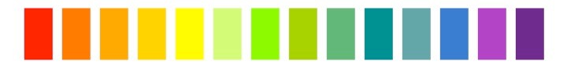
Date: 06/10/21
Observation
Aim: To study pH, clarity and presence of living organism from two different water samples collected from two different water bodies.
Principle:
The productivity and the trophic status of a water body is determined by assessing the number and type of organisms (micro as well as macros) present in the water body. The productive water bodies support fairly large number of organisms of different trophic levels. Water body with very high density of phytoplankton (free floating microscopic plants) and zooplanktons (free floating microscopic animals) per unit area is a productive water body. Such water bodies are usually turbid and have high amounts of nutrients and dissolved oxygen. Turbidity is the measure of the relative clarity or cloudiness of a liquid which is indirectly a measure of the amount of suspended particles in the water. Turbidity of the water body determines the depth to which light can penetrate and thus affects the distribution photosynthetic life forms. Tyndall Effect is a physical phenomena which is useful for determining turbidity of liquid. The Tyndall Effect is scattering of light by particles in a suspension. Turbid water shows Tyndall effect.
The pH is is another physical property of water. It is a measure of the relative amount of free hydrogen and hydroxyl ions in an aqueous solution. Solutions with a pH less than 7 are said to be acidic and with a pH greater than 7 are basic. The pH of pure water is 7 at 25°C. The pH value of a water sample can be determined by pH paper, universal indicator and pH meter.
Requirements: Pond water sample, bore well water sample, beakers, test tubes, droppers, pH paper strips, universal indicator, glass slides, cover slips, filter paper, needle, brush, microscope, torch or laser, 5% Formalin Aceto Alcohol (Formalin: Acetic acid: Ethanol in ratio of 5:5:90)
Procedure to check pH of water samples
Take a pH paper strip and dip into the beaker that contains water sample.
Wait for some time to dry the pH paper.
Note the colour and compare with the pH colour chart and get a rough estimate of pH of the water sample.
*pH of water sample can be checked by adding 5 drops of universal indicator into the test tubes and comparing the colour developed and colour chart of universal indicator.
Procedure to study of turbidity of water Samples
Take the water samples in separate beakers.
In dark room, pass beam of light from a torch or laser through the beakers with sample water.
Observe for Tyndall effect or whether the beam of light passes straight through without scattering.
Acidic
Basic
Neutral
1 2 3 4 5 6 7 8 9
10 11 12 13 14
Figure pH scale
Table pH of water samples
Water Samples | pH
Pond water | 8
Bore well water | 5
Beaker with bore well water
(Less turbid)
Beaker with pond water
(More turbid)
Figure Tyndall effect observed when beam of light passed through water samples
Must watch video link: https://youtu.be/RVpSPidRhM8

Slide 39
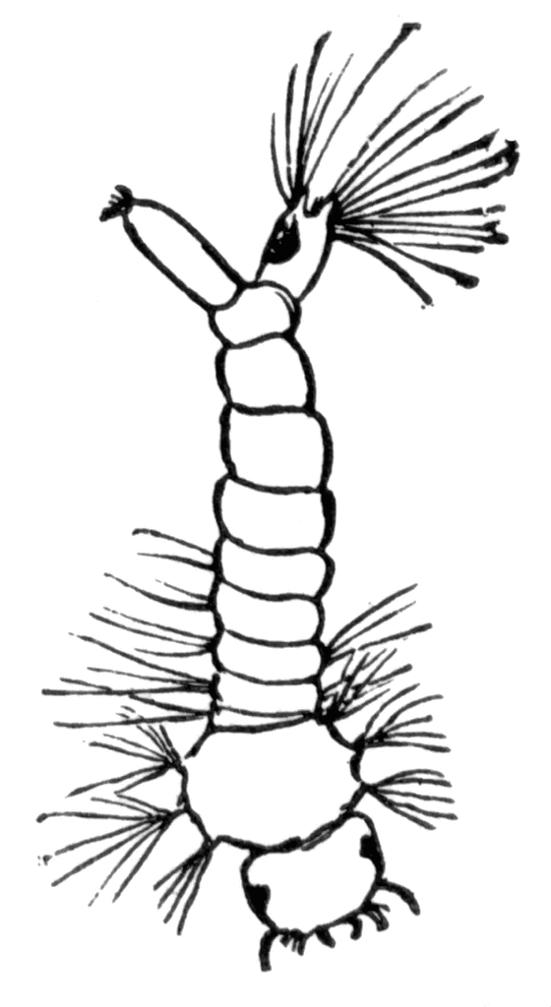
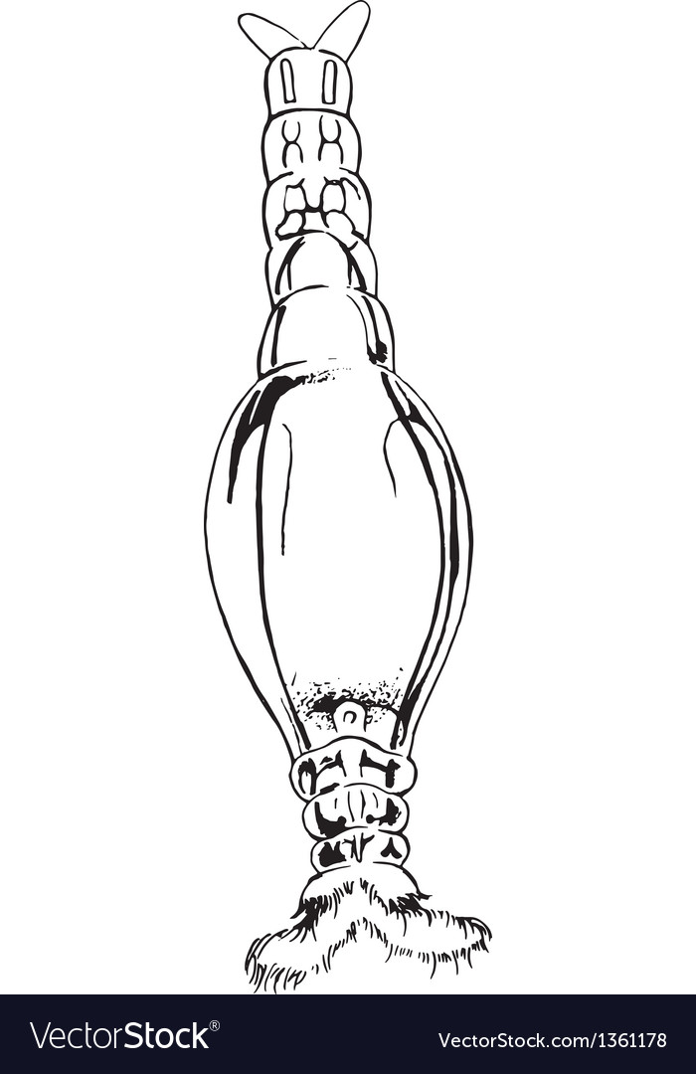
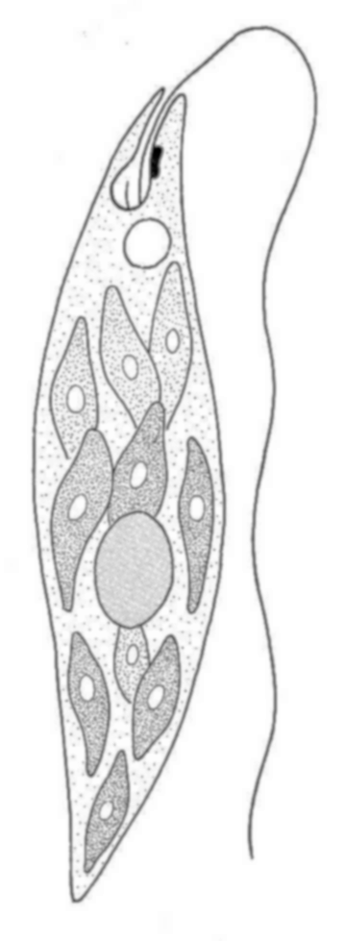
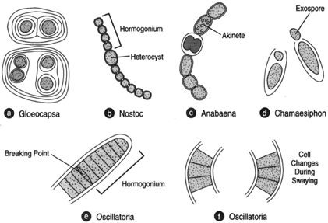
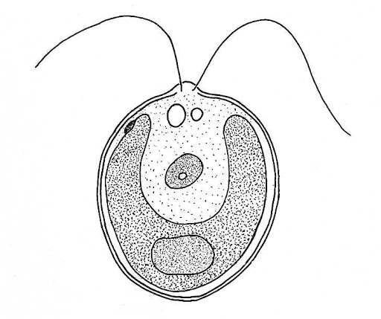
Procedure to analyse Living Organisms in Water Sample:
Add water sample into separate test tubes.
Add about 5 ml of FAA (Formalin Aceto Alcohol) to fix and preserve the living organisms present in each sample.
Leave the water sample undisturbed till the sediment settles to the bottom of the test tube.
Decant the clear water, leaving concentrated sediment at the bottom of the test tube.
With the help of a dropper, transfer a drop of water from the test tube to the center of a glass slide.
Take a cover slip and place it gently on the slide with the aid of a needle.
Remove the extra water using a filter paper.
Place this glass slide on the stage of the compound microscope and observe it.
Observation:
The pH of the bore well water was observed 8 and pond water was found to be pH 5.
Larvae of insects, protists, algae, etc were observed in water samples. Nostoc, Chlamydomonas, and rotifers were identified present in the pond water.
Pond water was found to be less turbid as it showed lesser beam of light are scattered whereas bore well water exhibited Tyndall effect and hence bore well water was found more turbid.
Observation
Mosquito larva
Rotifer
Euglena
Anabaena
Nostoc
Chlamydomonas
Figure Microscopic view of living forms observed in the water sample

Slide 40
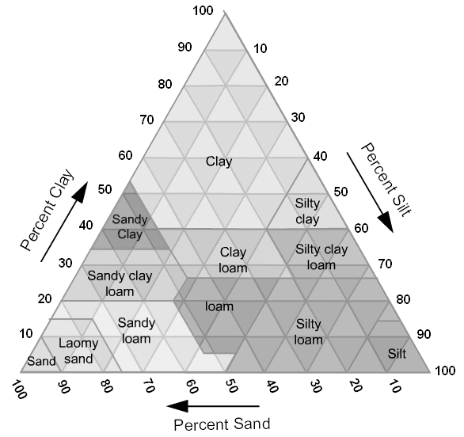
Observation
Aim: To study texture, moisture content, pH and water holding capacity of soil from at least two different sites and correlate with the kinds of plants found in them.
Theory:
Soil is the top most layer of the earth crust containing humus. It consist rock and mineral particles mixed with decayed organic matter. Soil, air and water are the three most important natural resources that sustains living forms. A productive soil contains approximately 46% mineral matter, 4% organic matter, 25 % water and 25% air.
Texture of soil i.e percentage of clay (<0.002 mm), silt (0.002-0.05 mm) and sand (0.05-2 mm) based on which classes of soil can be determined. The soil texture triangle is a tool used to visualise and understand the texture of the soil.
Texture of soil effects physicochemical properties of soil like density, capillary and non-capillary pore spaces, water holding capacity, aeration, temperature and root penetration.
The pH of the soil effects chemical property of it. The pH soil indicates acidity or alkalinity of soils. The pH of soil is important in determining the availability of minerals for plants. Different plants require differing optimum pH soil. The majority of plants survive at pH of 6 to 7 i.e. slightly acidic.
Water holding capacity of Soil is the amount of water retained in capillary spaces of soil after percolation of water into the deeper layers. This physical property of soil retain water for the plant to access. The amount of water available to plants is determined by the number and size of the pore spaces in soil. Fine sandy loam, silt loam and silty clay loam soil store the largest amount of water, whereas sandy, loamy sand and sandy loam have limited water storage capacity.
Requirements: roadside soil, garden soil, weighing balance, filter paper, funnel, test tubes, testtube stand, dropper, pH paper booklet, dropper, crucibles, wire gauze, Bunsen burner, mortar and pestle, perforated tin box, petri dish, beaker, measuring cylinder
Procedure to study pH of soil
Dissolve the two soil samples into two separate beaker containing water to make soil solution.
Using funnel with a filter paper, filter the two soil solutions separately by collecting the filtrate into separate test tubes.
Check pH of the filtrate of the two soil solution using pH paper strips.
Wait for some time for the pH paper strip to dry.
Estimate of pH of the soil solutions by comparing the colour of dried pH strips with the colour chart of broad range pH indicator.
* pH of filtrate of the soil solution can be checked by adding 5 drops of universal indicator into the test tubes and comparing the colour developed and colour chart of universal indicator.
Figure Soil textural triangle showing 12 textural classes based on the percentage of sand, silt, and clay in each
Table pH of soil samples
Soil Samples | pH
Garden soil | 6
Roadside soil | 7
Must watch video link: https://youtu.be/POivZf4vc-c

Slide 41
Observation
Procedure to study moisture content of soil
Weigh the dried clean crucibles.
Weigh the crucibles with soil sample on a weighing balance.
Heat dry the soil in crucible over Bunsen burner.
Weigh the dry weight of dried soil in the crucible.
Record the weight in form of table.
Procedure to study water holding capacity of soil
Experiment I
Put the two funnels placed with filter paper at the mouth of two different measuring cylinders.
Put the 25 g of garden and road side soil samples in these funnels.
Add 25 ml of water in each of these funnels of the setup.
Let the water drip into the measuring cylinder.
Note the volume of water collected.
OR
Experiment II
Grind the soil samples separately using motor and pestle into fine powder.
Place a filter paper in the bottom of perforated tin box.
Weigh the tin with the filter paper and note its weight.
Transfer the fine powdered soil sample into the tin box.
Fill soil samples compactly to form uniform layer at the top.
Weigh the tin box with soil sample and note its weight.
Take a petri dish filled with water and place two small glass rods parallel each other.
Place the soil filled tin on the two glass rods in such a manner that its bottom is in contact with water.
Leave the set up undisturbed till entire layer of soil surface is wet.
Remove the tin with wet soil and allow excess water to flow out from the bottom.
When no more water percolates, wipe the bottom to dry it with a filter paper.
Weigh it again and note its weight.
Record all the values of weight in form of table.
Procedure to study the texture of the soil
Take 25 gm of soil sample and put it into a 250 ml measuring cylinder.
Add 100 ml water into the measuring cylinder and shake it to mix the soil sample.
Allow the soil particles to settle down.
Record the thickness of different layers formed by different types of particles in the measuring cylinder.
Using a textural triangle, determine the texture of soil.
Table Moisture content of soil
Soil sample | Weight of crucible (A) | Weight of crucible + Soil sample (B) | Weight of soil sample B-A = C | Weight of crucible + dried soil sample (D) | Weight of dried soil D -A = E | Amount of moisture content C -E = N | % of moisture content N/C x 100
Garden soil | 25 g | 55 g | 30 g | 53.8 g | 28.8 g | 1.2 | 4 %
Roadside soil | 25 g | 54.6 g | 29.6 | 54.2 g | 29.2 | 0.4 | 1.3 %
Table Water holding capacity of soil (for experiment I)
Soil sample | Weight of the soil (g) X | Volume of water added (ml) Y | Volume of water collected (ml) Z | Volume of water retained (ml) Y-Z | Water holding capacity (%) Y-Z/X x 100
Garden soil | 25 g | 25 ml | 21 ml | 4 ml | 4/25 x 100 = 16%
Roadside soil | 25 g | 25 ml | 23.5 ml | 1.5 ml | 1.5/25 x 100 = 6 %
Table Water holding capacity of soil (for experiment II)
Soil sample | Weight of tin + blotting paper (A) | Weight of tin + blotting paper + soil sample (B) | Weight of soil sample B-A = C | Weight of tin + blotting paper + wet soil sample (D) | Weight of wet soil D -A = E | Amount of water absorbed E-C = N | % of water holding capacity N/C x 100
Garden soil | 39 g | 246 g | 207 g | 280 g | 241 g | 34 | 16.42%
Roadside soil | 39 g | 340 g | 301 g | 360 g | 321 g | 20 | 6.64%
Figure Layers of soil particles in soil solution in measuring cylinder
Table Texture class of given soil sample
Soil Samples | Percentage (%) |  |  | Texture class
 | Sand | Silt | Clay
Garden soil | 60% | 28% | 10% | Sandy loam
Roadside soil | 80% | 89% | 12% | Loamy sand

Slide 42
Discussion
The physical properties of soil like texture, moisture content, pH and water holding capacity affect the growth of plants. pH of the roadside soil and the garden soil was found to be around 7 i.e neutral (neither acidic nor basic). The pH range of approximately 6 to 7 promotes the most ready availability of plant nutrients. But some plants, such as blueberries, white potatoes and conifer trees, tolerate strong acid soils and grow well. Some plants survive well only in slightly acid to moderately alkaline soils.
Garden soil shows higher moisture content than the roadside soil. The garden soil was found to be sandy loam with 10% clay, 60% sand, and 28% silt. The road side soil with 12% clay, 80% sand, and 89% silt was identified as loamy sand.
The variation in water holding capacity is due to varying proportion of sand, silt and clay in the soil of different habitats. Soil with very high proportion of sand have very low water holding capacity due to large pore spaces between the particles which enables the water to percolate freely into deeper layers leaving upper layers practically dry. In clay soil, due to very small size of the pore spaces (fine capillaries) the water is retained in the capillary spaces as capillary water. In these soil the water does not percolate freely. Soil with more or less equal proportion of sand, silt and clay (loam soil) combines the properties of sand and clay and therefore has optimum water holding capacity and optimum soil-air for root growth.
In sandy soil the non-capillary pore spaces will be more and the capillary pore spaces will be less. The condition will be reverse in case of clay soil. The pore space in turn determines water holding capacity, percolation rate, aeration, root penetration and soil flora and fauna. Clay particles are anionic colloides and adsorb mineral nutrients and minimise their leaching.

Slide 43
SPOTTINGS
TERM - II
B.6 Common disease causing organisms like Ascaris, Entamoeba, Plasmodium, any fungus causing ringworm through permanent slides, models or virtual images. Comment on symptoms of diseases that they cause.
B.7 Two xeric plants and two xeric animals (models/virtual images). Comment upon their morphological adaptations.
B.8 Two aquatic plants and two aquatic animals (models/virtual images). Comment upon their morphological adaptations.

Slide 45
INDEX
S.No. | Title of the experiment | Date | Remarks
 | Major Experiment
1 | Isolate DNA from available plant material
2 | Prepare a temporary mount to observe pollen germination.
 | Spottings
1 | Flowers adapted to pollination by different agencies (wind, insects, birds).
2 | Identification of stages of gamete development, i.e., T.S. of testis and T.S. of ovary through permanent slides (from grasshopper/mice).
3 | Meiosis in onion bud cell or grasshopper testis through permanent slides.
4 | T.S. of blastula through permanent slides (Mammalian).
5 | Prepared pedigree charts of any one of the genetic traits such as rolling of tongue, blood groups, ear lobes, widow's peak and colour blindness.

Slide 46
Observation
Now slowly tap the cover slip using the blunt end of a pencil so that the meristematic tissue of the root tip below the cover slip is properly squashed and spread as a thin layer of cells. Carefully seal the margins of the cover slip using molten paraffin wax or nail polish.
This preparation of onion root tips cells is now ready for the study of mitosis.
Observe the slide on the stage of a good quality compound microscope.
First observe it under the lower magnification (10 X objective) to search for the area having a few dividing cells.
Examine the dividing cells under higher magnification of the microscope to observe the detailed features of mitosis.
Observation
The stages of mitosis can be broadly categorised into two parts: karyokinesis (division of nucleus) followed by cytokinesis (division of cytoplasm, and ultimately of the cell). Those cells, which are not in the phases of cell division are considered to be in interphase. Most of the cells in a microscope field are in interphase few cells are found in other stages of cell cycle.
Interphase
The cells are mostly rectangular, oval or even circular in shape, with almost centrally situated densely stained nucleus. The chromatic (coloured) material of the nucleus is homogeneous and looks granular. The boundary of the nucleus is distinct. One or few nucleoli (sing: nucleolus) can also be observed inside the nucleus.
Prophase
Intact nuclear outline is seen. The chromatin (seen as a homogeneous material in the nucleus at interphase) appears as a network of fine threads(chromosomes). Few cells are found in the early stage of prophase with thing chromatin fibres (chromosomes). However, cells at late prophase were observed with comparatively thicker chromatin fibres. Besides this, in the late prophase the nuclear membrane may not be noticed.
Metaphase
The nuclear membrane disappears. Chromosomes are thick and are seen arranged at the equatorial plane of the cell. Each chromosome at this stage has two chromatids joined together at the centromere, which can be seen by changing the resolution of the microscope. Nucleolus is not observed during metaphase.
Anaphase
This stage shows the separation of the chromatids of each chromosome. The chromatids separate due to the splitting of the centromere. Each chromatid now represents a separate chromosome as it has its own centromere. The chromosomes are found as if they have moved towards the two poles of the cell. The chromosomes at this stage may look like the shape of alphabets 'V','J' or 'I' depending upon the position of centromere in them. Different anaphase cells show different stages of movement of chromosomes to opposite poles, and they are designated to represent early, mid and late anaphase
Interphase
Prophase
Metaphase
Anaphase
Telophase
Cytokinesis
Figure Microscopic view on left side and its diagrammatic representation on the right hand side

Slide 47
Telophase
Chromosomes reach the opposite poles, lose their individuality, and look like a mass of chromatin. Nuclear membrane reappears to form the nuclei of the two future daughter cells.
Cytokinesis
In plants, a cell plate is formed in the middle after telophase. The plate can be seen to extend outwards to ultimately reach the margin of the cell and divide the cell into two. Such cell plates are characteristic of plant cells. However, in an animal cell, the two sides of the cell show constrictions formed from the peripheral region in the middle of the cell, which grow inward and meet to divide the cell into two daughter cells.
Discussion
Mitotic index (MI) is defined as a ratio of the total number of dividing cells (n) and the total number of cells (N) in a particular focus chosen randomly under the microscope and is calculated as MI = n/N x100. By randomly selecting 5 to 10 such foci, one can estimate the mitotic index for a given type.
The effect of different samples of water (polluted or contaminated) can be assayed on the mitotic-index (an indicative feature of somatic growth rate in them).Further, the impact of different types of pollutants on different phases of mitosis can also be assayed
Precautions
Careful while placing the coverslip to avoid any bubble in the slide.
Do not apply too much of pressure on the cover slip. It may break.
Calculation of Mitotic index (MI)
Mitotic index (MI) = n/N x100
= 15/65 x 100
= 0.23 x 100
= 0.0023

Slide 48
Aim: To prepare a temporary mount to observe pollen germination.
Principle:
In nature, pollen grains germinate and form pollen tubes after they get deposited by the process of pollination on compatible stigma. Pollen grains can be induced to germinate in a synthetic nutrient medium. Pollen tube is made up of cellulose, is an extension of intine -the inner wall of pollen grain. It emerges through one of the germ pore and passes through tissues of stigma and style to reach the ovule. The growing pollen tube is observed by staining with cotton blue. Pollen grain contains two cells
vegetative/tube cell (bigger in size, with irregularly shaped nucleus, dense cytoplasm, has abundant food reserve)
generative cells (spindle shaped, small and floats in the cytoplasm of the vegetative cell)
Generative cell divides mitotically to give rise to the two male gametes.
Requirement: Freshly plucked flowers with mature pollen grains of (china rose, petunia, sun flower, etc), petridish, glass slides, coverslips, brush, needle, microscope, beaker, 10% sucrose solution, bori acid, calcium nitrate, magnesium sulphate, potassium nitrate
Preparation of nutrient solution:
Method I: Dissolve dissolving 10 g sucrose, 30 mg calcium nitrate and 10 mg boric acid in 100ml of distilled water.
Method II: Dissolve 10 grams sucrose, 10 milligrams boric acid, 30 milligrams magnesium sulphate and 20 milligrams potassium nitrate in 100ml of distilled water.
Procedure:
Prepare the nutrient medium of 10% sucrose solution.
Take a drop of 10% sucrose solution on a clean glass slide.
Sprinkle few pollen grains from mature stamen to the slide.
Place the cover slip over the glass slide and gently press it.
After 5 minutes, place the glass slide on the stage of the compound microscope.
Observe the slide through the microscope regularly for about half an hour.
Discussion:
Although pollen grains of many species germinate and put forth pollen tubes in this medium, the time taken for germination varies indifferent species. In the nutrient medium, the pollen grain germinates. The tube cell enlarges and comes out of the pollen grain through one of the germ pores to form a pollen tube. The tube nucleus descends to the tip of the pollen tube. The generative cell while passing through pollen tube divides into two male gametes.
Precautions
Freshly picked flowers should have mature stamens with dehisced pollen grains.
You should stain the specimen well. Extra stain should be removed using blotting paper.
Careful while placing the coverslip to avoid any bubble in the slide.
Do not apply too much of pressure on the cover slip. It may break.
Observation
Figure Microscopic view of germination of pollen
Must watch video link: https://youtu.be/S4wAtd11S5Y

Slide 49
Observation
Aim: To study texture, moisture content, pH and water holding capacity of soil from at least two different sites and correlate with the kinds of plants found in them.
Theory:
Soil is the top most layer of the earth crust containing humus. It consist rock and mineral particles mixed with decayed organic matter. Soil, air and water are the three most important natural resources that sustains living forms. A productive soil contains approximately 46% mineral matter, 4% organic matter, 25 % water and 25% air.
Texture of soil i.e percentage of clay (<0.002 mm), silt (0.002-0.05 mm) and sand (0.05-2 mm) based on which classes of soil can be determined. The soil texture triangle is a tool used to visualise and understand the texture of the soil.
Texture of soil effects physicochemical properties of soil like density, capillary and non-capillary pore spaces, water holding capacity, aeration, temperature and root penetration.
The pH of the soil effects chemical property of it. The pH soil indicates acidity or alkalinity of soils. The pH of soil is important in determining the availability of minerals for plants. Different plants require differing optimum pH soil. The majority of plants survive at pH of 6 to 7 i.e. slightly acidic.
Water holding capacity of Soil is the amount of water retained in capillary spaces of soil after percolation of water into the deeper layers. This physical property of soil retain water for the plant to access. The amount of water available to plants is determined by the number and size of the pore spaces in soil. Fine sandy loam, silt loam and silty clay loam soil store the largest amount of water, whereas sandy, loamy sand and sandy loam have limited water storage capacity.
Requirements: roadside soil, garden soil, weighing balance, filter paper, funnel, test tubes, testtube stand, dropper, pH paper booklet, dropper, crucibles, wire gauze, Bunsen burner, mortar and pestle, perforated tin box, petri dish, beaker, measuring cylinder
Procedure to study pH of soil
Dissolve the two soil samples into two separate beaker containing water to make soil solution.
Using funnel with a filter paper, filter the two soil solutions separately by collecting the filtrate into separate test tubes.
Check pH of the filtrate of the two soil solution using pH paper strips.
Wait for some time for the pH paper strip to dry.
Estimate of pH of the soil solutions by comparing the colour of dried pH strips with the colour chart of broad range pH indicator.
* pH of filtrate of the soil solution can be checked by adding 5 drops of universal indicator into the test tubes and comparing the colour developed and colour chart of universal indicator.
Figure Soil textural triangle showing 12 textural classes based on the percentage of sand, silt, and clay in each
Table pH of soil samples
Soil Samples | pH
Garden soil | 6
Roadside soil | 7
Must watch video link: https://youtu.be/POivZf4vc-c

Slide 50
Procedure to study moisture content of soil
Weigh the dried clean crucibles.
Weigh the crucibles with soil sample on a weighing balance.
Heat dry the soil in crucible over Bunsen burner.
Weigh the dry weight of dried soil in the crucible.
Record the weight in form of table.
Procedure to study water holding capacity of soil
Grind the soil samples separately using motor and pestle into fine powder.
Place a filter paper in the bottom of perforated tin box.
Weigh the tin with the filter paper and note its weight.
Transfer the fine powdered soil sample into the tin box.
Fill soil samples compactly to form uniform layer at the top.
Weigh the tin box with soil sample and note its weight.
Take a Petri dish filled with water and place two small glass rods parallel each other.
Place the soil filled tin on the two glass rods in such a manner that its bottom is in contact with water.
Leave the set up undisturbed till entire layer of soil surface is wet.
Remove the tin with wet soil and allow excess water to flow out from the bottom.
When no more water percolates, wipe the bottom to dry it with a filter paper.
Weigh it again and note its weight.
Record all the values of weight in form of table.
Procedure to study the texture of the soil
Take 25 gm of soil sample and put it into a 250 ml measuring cylinder.
Add 100 ml water into the measuring cylinder and shake it to mix the soil sample.
Allow the soil particles to settle down.
Record the thickness of different layers formed by different types of particles in the measuring cylinder.
Using a textural triangle, determine the texture of soil.
Discussion
The physical properties of soil like texture, moisture content, pH and water holding capacity affect the growth of plants. pH of the roadside soil and the garden soil was found to be around 7 i.e neutral (neither acidic nor basic). The pH range of approximately 6 to 7 promotes the most ready availability of plant nutrients. But some plants, such as blueberries, white potatoes and conifer trees, tolerate strong acid soils and grow well. Some plants survive well only in slightly acid to moderately alkaline soils.
Garden soil shows higher moisture content than the roadside soil. The garden soil was found to be sandy loam with 10% clay, 60% sand, and 28% silt. The road side soil with 12% clay, 80% sand, and 89% silt was identified as loamy sand.
Observation
Table Moisture content of soil
Soil sample | Weight of crucible (A) | Weight of crucible + Soil sample (B) | Weight of soil sample B-A = C | Weight of crucible + dried soil sample (D) | Weight of dried soil D -A = E | Amount of moisture content C -E = N | % of moisture capacity N/C x 100
Garden soil | 25 g | 55 g | 30 g | 53.8 g | 28.8 g | 1.2 | 4 %
Roadside soil | 25 g | 54.6 g | 29.6 | 54.2 g | 29.2 | 0.4 | 1.3 %
Table Water holding capacity of soil
Soil sample | Weight of tin + blotting paper (A) | Weight of tin + blotting paper + soil sample (B) | Weight of soil sample B-A = C | Weight of tin + blotting paper + wet soil sample (D) | Weight of wet soil D -A = E | Amount of water absorbed E-C = N | % of water holding capacity N/C x 100
Garden soil
Roadside soil
Figure Layers of soil particles in soil solution in measuring cylinder
Table Texture class of given soil sample
Soil Samples | Percentage (%) |  |  | Texture class
 | Sand | Silt | Clay
Garden soil | 60% | 28% | 10% | Sandy loam
Roadside soil | 80% | 89% | 12% | Loamy sand
Must watch video link: https://youtu.be/POivZf4vc-c

Slide 51
The variation in water holding capacity is due to varying proportion of sand, silt and clay in the soil of different habitats. Soil with very high proportion of sand have very low water holding capacity due to large pore spaces between the particles which enables the water to percolate freely into deeper layers leaving upper layers practically dry. In clay soil, due to very small size of the pore spaces (fine capillaries) the water is retained in the capillary spaces as capillary water. In these soil the water does not percolate freely. Soil with more or less equal proportion of sand, silt and clay (loam soil) combines the properties of sand and clay and therefore has optimum water holding capacity and optimum soil-air for root growth.
In sandy soil the non-capillary pore spaces will be more and the capillary pore spaces will be less. The condition will be reverse in case of clay soil. The pore space in turn determines water holding capacity, percolation rate, aeration, root penetration and soil flora and fauna. Clay particles are anionic colloides and adsorb mineral nutrients and minimise their leaching.

Slide 52
Observation Table
Aim: To study the effect of different temperatures and three different pH on the activity of salivary amylase on starch.
Theory:
In human, digestion of starch starts in oral cavity. It is achieved in presence of salivary amylase at pH of 6.8 and temperature of 37 ºC and produce disaccharide (maltose). The complete digestion of starch occurs only in the small intestine by the action of pancreatic amylase.
As enzymes are proteinaceous, they get deactivated at lower temperature denatured at the higher temperature. Hence, more time will be taken by an enzyme to digest the starch at lower and higher temperatures. Optimum temperature for the enzymatic activity of salivary amylase ranges from 32 °C to 37 °C. The optimum temperature means that the temperature at which the enzyme shows the maximum activity. At this optimum temperature, the enzyme is most active and hence, takes less time to digest the starch.
The optimum pH for the enzymatic activity of salivary amylase ranges from 6 to 7. Above and below this range, the reaction rate reduces as enzymes get denatured. The enzyme salivary amylase is most active at pH 6.8.
The effect of temperature and pH on the activity of salivary amylase on starch can be studied by using the Iodine test. If we add saliva on starch, the salivary amylase present in saliva gradually acts on starch and converts it into maltose. Starch keeps on giving blue colour with iodine till it is completely digested into maltose. At this point, no blue colour is formed. This is the end point or achromic point.
Materials Required: Iodine solution, test tubes, ice cubes, water, 1% starch solution, 1% NaCl, saliva solution, droppers, thermometer, Bunsen burner and wire gauze, pH tablets of 5, 6.8 and 8, beaker
Procedure to study the effect of Different Temperatures on the Activity of Salivary Amylase on Starch
Prepare 15 ml of 1% starch solution and 3 ml of 1% NaCl solution in a beaker.
Divide and pour this solution into three test tubes and mark them as A, B and C.
Take a beaker containing ice cubes and maintain the temperature at 5°C.
Take another two beakers containing water and heat over the Bunsen burner.
Transfer the experimental tube A into a beaker containing ice.
Transfer the second experimental tube B into water bath set at 37°C and third experimental tube C into the beaker maintained at 50°C.
Using a dropper, add 1 ml saliva solution each into test tube A, B and C.
Using a fresh droppers, take few drops from experimental tube A, B and C and transfer these separately into set of three series of test tubes having iodine solution. Note this time as zero minute reading.
After an interval of 2 minutes, again add few drops each from the tubes A, B and C, and add to the test tubes containing iodine solution and note the change in colour of iodine.
Keep on repeating the experiment at an interval of every 2 minutes till colour of iodine does not change.
Table Effect of Different Temperatures on the Activity of Salivary Amylase on Starch
Temperature | Time taken
5°C | 16 minutes
37°C | 4 minutes
50°C | 12 minutes
To digest completely 5 ml of 1% starch solution, 1 ml of diluted enzyme takes 16 minutes at 5 °C, 4 minutes at 37 °C and 12 minutes at 50 °C.
Must watch video: https://youtu.be/iaqxTaXit9M

Slide 53
Observation Table
Procedure to study the effect of Different pH on the Activity of Salivary Amylase on Starch
Prepare 15 ml of 1% starch solution and 3 ml of 1% NaCl solution in a beaker.
Divide and pour this solution into three test tubes and mark them as A, B and C.
Add pH tablet 5 into test tube A, pH tablet 6.8 into test tube B and pH tablet 8 into test tube C.
Now transfer experimental tube A, B and C into a beaker containing water and a thermometer to maintain the temperature at 37°C.
Using a dropper, add 1 ml of saliva to each of the three test tubes.
Immediately using a separate fresh droppers, take few drops from experimental tube A, B and C, and transfer this into the three sets of series of test tubes having iodine solution.
Note this time as zero minute reading.
After an interval of 2 minutes, again take a drop from each tube and add to the iodine tubes and note the change in colour of iodine.
Keep on repeating the experiment at an interval of every 2 minutes till colour of iodine does not change.
Result:
The optimum temperature of salivary amylase was found to be 37°C, as the enzyme is maximum active at this temperature, while at higher and lower temperatures the enzyme is less active.
The optimum pH of the enzyme was found to be 6.8 (i.e., slightly acidic). pH 5 is acidic and pH 8 is alkaline, therefore salivary amylase did not act in these tubes.
Table Effect of Different pH on the Activity of Salivary Amylase on Starch
pH | Time taken
5 | 14 minutes
6.8 | 4 minutes
8 | 14 minutes
To digest completely 5 ml of 1% starch solution, 1 ml of diluted enzyme takes 14 minutes at pH 5, 4 minutes at pH 6.8 and 14 minutes at pH 8.

Slide 54
Observation
Aim: Isolate DNA from available plant material such as spinach, green pea seeds, papaya, etc.
Principle:
Deoxyribonucleic acid (DNA) is a long polymer of deoxyribonucleotides. It acts as the genetic material/genome in most of the organisms. The length of DNA is usually determined by base pairs (number of nucleotides/a pair of nucleotide). The human genome contains 3164.7 million nucleotide bases.
Each organism has its unique length of DNA. Pure DNA from a living cells can be isolated by breaking the cell with different enzymes lysozyme (bacteria), cellulase (plant cells), chitinase (fungus), lipase, etc. The RNA and proteins can be removed by treating with ribonuclease and protease respectively. The purified DNA can be precipitated out by chilled ethanol. Precipitated pure DNA appear as a collection of fine threads in the suspension. DNA that separates out can be removed by spooling using glass rod.
Requirement: Any available plant material (spinach, green pea seeds, papaya, etc.), mortar and pestle, test tubes, beakers, ethanol, liquid detergent/ meat tenderizer,
Procedure
Grind the plant sample using mortar and pestle with little amount of water and sodium chloride.
Transfer the homogenised plant material into a beaker.
Add liquid detergent or meat tenderizer to it and mix it properly with a glass rod for 3-5 minutes.
Filter the mixture using a sieve into a clean, dry and sterilised test tube.
Tilt the test tube with filtrate, and add chilled ethanol to allow precipitation of DNA.
After half-an-hour we can observe the precipitated DNA suspended in the supernatant as collection of fine threads.
DNA can be removed by spooling using glass rod.
Observation
The DNA appears as white precipitates of collection of fine threads at the top layer of ethanol.
Discussion:
Isolation of DNA involves mechanical method and use of enzymes. Grinding and crushing the plant sample using motor and pestle degrades the cell walls and membranes. The liquid detergent degrades membrane phospholipids and proteins, releasing the DNA . The sodium cations from the salt shield the negatively charged DNA molecules and allow collection and extraction of DNA in the mixture. Chilled ethanol precipitate DNA in the supernatant. The DNA is the white material in the clear top layer of alcohol layer and removed by spooling using glass rod.
Collection of fine threads of DNA
Chilled ethanol
Figure Spooling of DNA
Must watch video: https://youtu.be/boMZ_Y_OW3Y

Slide 55
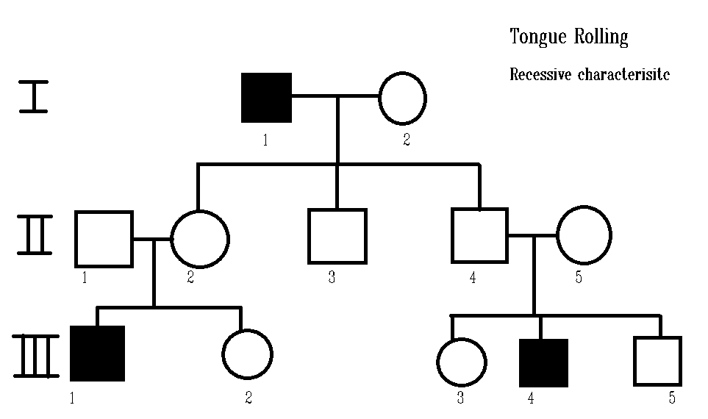
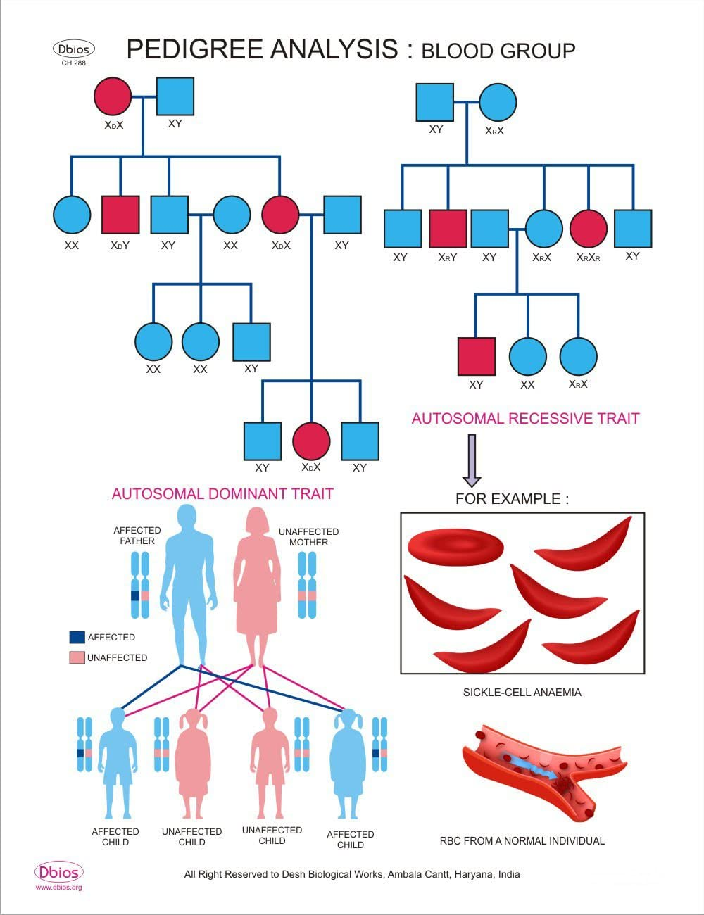
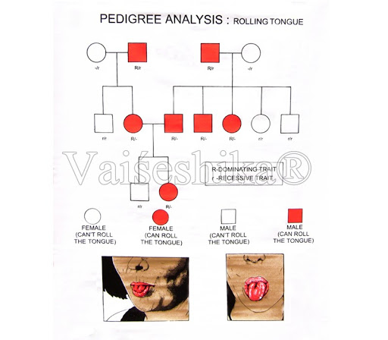

Slide 56
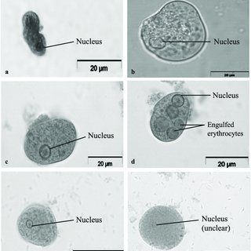
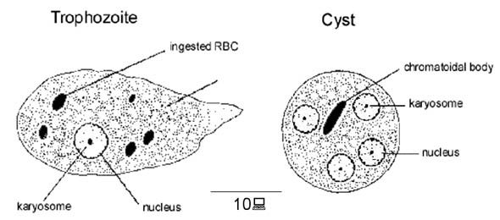
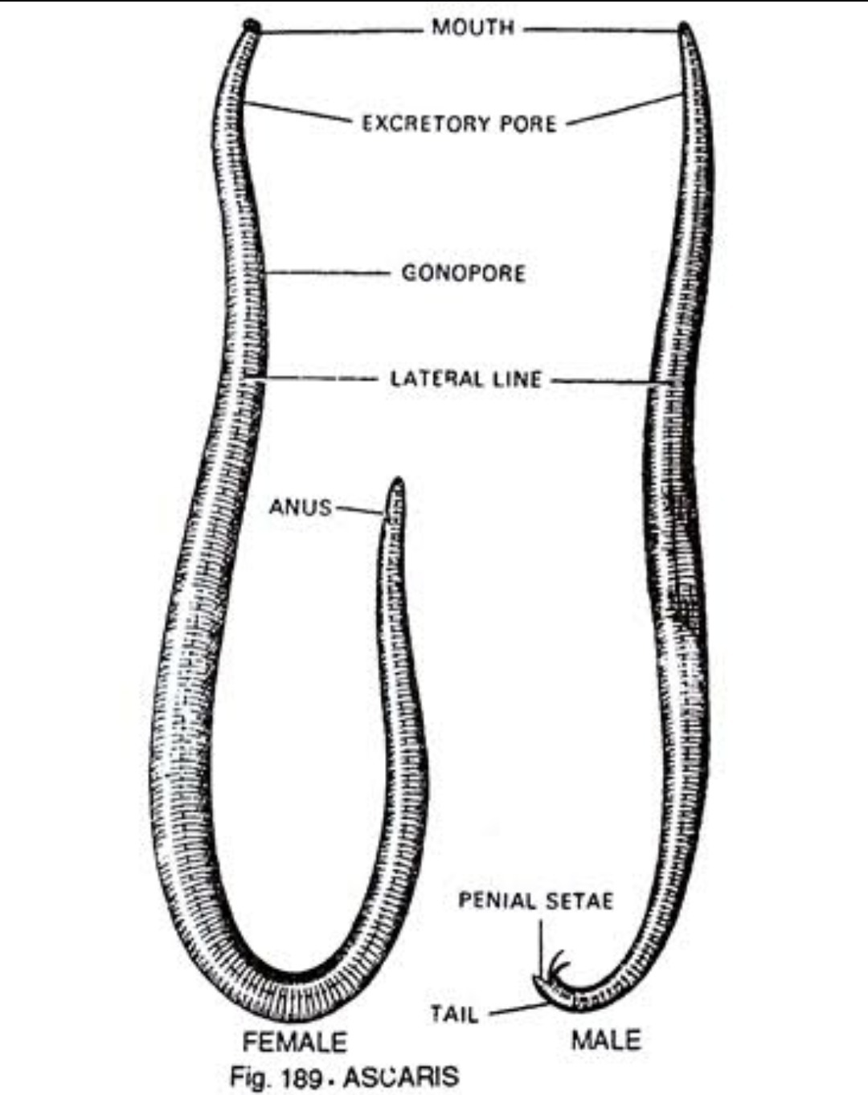
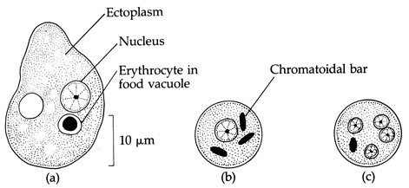
Observation
Aim: T.S. of blastula through permanent slides (Mammalian)
Requirement: Permanent slide, chart/model of T.S. of blastula, compound microscope, lens cleaning fluid and paper
Procedure
Place the slide on the stage of the microscope and observe for feature of blastula at lower magnification.
Observation
Ascaris –a helminths
Ascaris lumbricoides is the "large roundworm" growing to a length of up to 35 cm.
It is an intestinal parasite and causes Ascariasis.
Symptoms of ascariasis can be Internal bleeding, muscular pain, fever, anemia and blockage of the intestinal passage.
The eggs of the parasite are excreted along with the faeces of infected persons which contaminate soil, water, plants, etc. A healthy person acquires this infection through contaminated water, vegetables, fruits, etc.
Figure Diagrammatic of microscopic view of Entamoeba

Slide 57
Observation
Aim: T.S. of blastula through permanent slides (Mammalian)
Requirement: Permanent slide, chart/model of T.S. of blastula, compound microscope, lens cleaning fluid and paper, specimen of ascaris
Observation
Ascaris –a helminths
Ascaris lumbricoides is a large roundworm, growing to a length of up to 35 cm.
It is an intestinal parasite and causes Ascariasis.
Symptoms of ascariasis can be Internal bleeding, muscular pain, fever, anemia and blockage of the intestinal passage.
The eggs of the parasite are excreted along with the faeces of infected persons which contaminate soil, water, plants, etc.
A healthy person acquires this infection through contaminated water, vegetables, fruits, etc.
Figure Diagrammatic of microscopic view of Entamoeba

Slide 58
Major experiment (5 Marks)
Isolation of DNA
Effect of pH and temperature on activity of starch
Minor experiment
Water analysis (pH, clarity and presence of living organisms)
Salt analysis (pH, texture, moisture content and water holding capacity)
Slide Preparation
Temporary mount of pollen germination and onion root tip mitosis.
Spotting
Flowers adapted to pollination by wind.
Flowers adapted to pollination by insects.
Flowers adapted to pollination by birds.
Identification of stages of gamete development in T.S. of testis through permanent slides (from grasshopper/mice).
Identification of stages of gamete development in T.S. of ovary (from grasshopper/ mice).
Meiosis in onion bud cell or grasshopper testis through permanent slides.
T.S. of blastula through permanent slides (Mammalian).
Pedigree charts of rolling of tongue.
Pedigree charts of blood groups.
Pedigree charts of ear lobes, widow's peak.
Pedigree charts of rolling of colour blindness.
Comment on following disease causing organisms and write the symptoms of disease
Ascaris Common disease causing organisms
Entamoeba - Common disease causing organisms
Plasmodium - Common disease causing organisms
Fungus causing ringworm
Morphological adaptations of opuntia found in –a xerophyte.
Morphological adaptations of Aloe –a xerophyte.
Morphological adaptations of camel –a xeric animal.
Morphological adaptations of python (Ajgar) –a xeric animal.
Morphological adaptations of Eichhornia (water hyacinth)–a hydrophyte.
Morphological adaptations of Nelumbo (Lotus) –an aquatic plant.
Morphological adaptations of Carp (Labeo rohita)–an aquatic animal.
Morphological adaptations of Frog (Rana tigrina)–an aquatic animal.

Slide 59
Common disease causing organisms like Ascaris, Entamoeba, Plasmodium, any fungus causing ringworm through permanent slides, models or virtual images. Comment on symptoms of diseases that they cause.
Two plants and two animals (models/virtual images) found in xeric conditions. Comment upon their morphological adaptations.
Two plants and two animals (models/virtual images) found in aquatic conditions. Comment upon their morphological adaptations.
Write five appropriate comments in addition to diagrams about the following spotters should be written in your record files.
Flowers adapted to pollination by wind.
Flowers adapted to pollination by insects.
Flowers adapted to pollination by birds.
Identification of stages of gamete development in T.S. of testis through permanent slides (from grasshopper/mice).
Identification of stages of gamete development in T.S. of ovary (from grasshopper/ mice).
Meiosis in onion bud cell or grasshopper testis through permanent slides.
T.S. of blastula through permanent slides (Mammalian).
Pedigree charts of rolling of tongue.
Pedigree charts of blood groups.
Pedigree charts of ear lobes, widow's peak.
Pedigree charts of rolling of colour blindness.
Comment on following disease causing organisms and write the symtoms of disease
Ascaris Common disease causing organisms
Entamoeba - Common disease causing organisms
Plasmodium - Common disease causing organisms
Fungus causing ringworm
Two plants and two animals (models/virtual images) found in xeric conditions. Comment upon their morphological adaptations.
Two plants and two animals (models/virtual images) found in aquatic conditions. Comment upon their morphological adaptations.

Slide 60
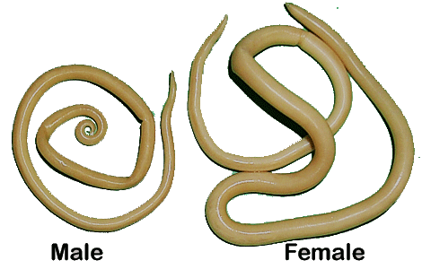
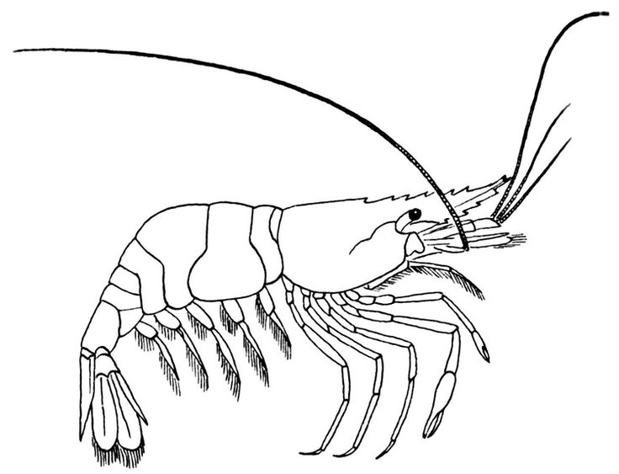
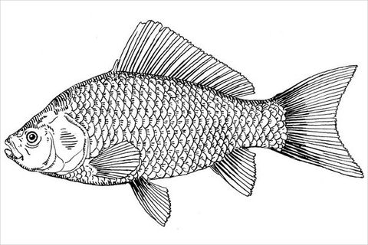
Spotting A
Spotting C
Spotting B
Spotting B

Slide 61
Ingested RBC
Nucleus
Trophozoite
Ectoplasm
Nucleus
Erythrocyte in food vacuole
Spotting A
Spotting C
Inflorescence
Leaf lamina
Petiole with air
Fibrous roots with feathery root hairs
Fragile stolen
Spotting B
Spotting B

Slide 62

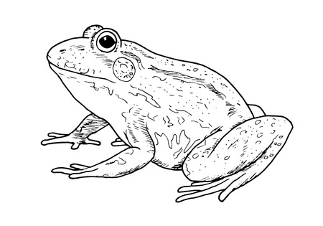
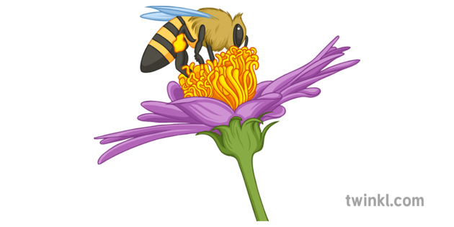

Slide 63
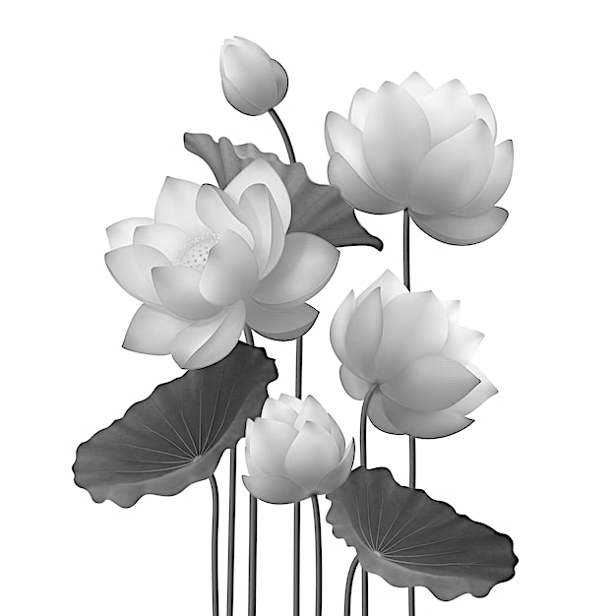
Spotting A
Spotting B
Spotting C
Spotting B
Spotting E
Spotting C

